Slide 1



Making better conservation decisions
Jeffrey Hanson
jeffrey.hanson@uqconnect.edu.au
jeffrey-hanson.com

Slide 2






Acknowledgements
Adam Marques
Ana Veríssimo
Amanda Martin
Angela Brennan
Brandon Edwards
Caitlyn Proctor
Cynthia Riginos
Emma Hudgins
Guillermo Velo-Antón
Iadine Chadès
Íñigo Martínez-Solano
Hugh Possingham
Jaimie Vincent
Jenny McCune
Jonathan Rhodes
Joseph Bennett
Josie Hughes
Lenore Fahrig
Miguel Camacho-Sanchez
Matthew Strimas-Mackey
Nina Morell
Peter Arcese
Richard Fuller
Richard Schuster
Richard Pither
Silvia Carvalho

Slide 3
Now
Biodiversity
Status quo
2000
Future

Slide 4
Now
How do we
get here?
Biodiversity
Status quo
2000
Future

Slide 5
How can we get a better conservation decision?
(1) Better algorithms
(2) Better data
(3) Better surrogates

Slide 6



Ecological surveys
Distribution maps
Priority areas
Biodiversity
2000
Future
Data
Information
Plan
Outcome
Objectives
Constraints

Slide 7
Ecological surveys
Distribution maps
Priority areas
Biodiversity
2000
Future
Data
Information
Plan
Outcome
Better
algorithms
Better
outcome
Objectives
Constraints

Slide 8
Reserve selection
Features
Notes:
- not all remaining habitat can be preserved
- achieve conservation objectives for minimal cost
- modern systematic conservation planning primarily focusses on representing species
- however, this ignores intra-specific biodiversity
8

Slide 9
Reserve selection
Planning units

Slide 10
Reserve selection
?
?
?
?
?
?

Slide 11
Reserve selection

Slide 12





Heuristic
algorithm
Meta-heuristic
algorithms
Exact
algorithms
Estimate of best quality
Quality
Different
solutions
Different
solutions
Different
solutions

Slide 13

prioritizr: Systematic conservation prioritization in R
it’s an R package (yes, this is good)
flexible interface to customize problems
compatible with tabular and GIS data formats
supports planning for multiple zones/actions
powered by exact algorithm solvers (commercial + free)

Slide 14
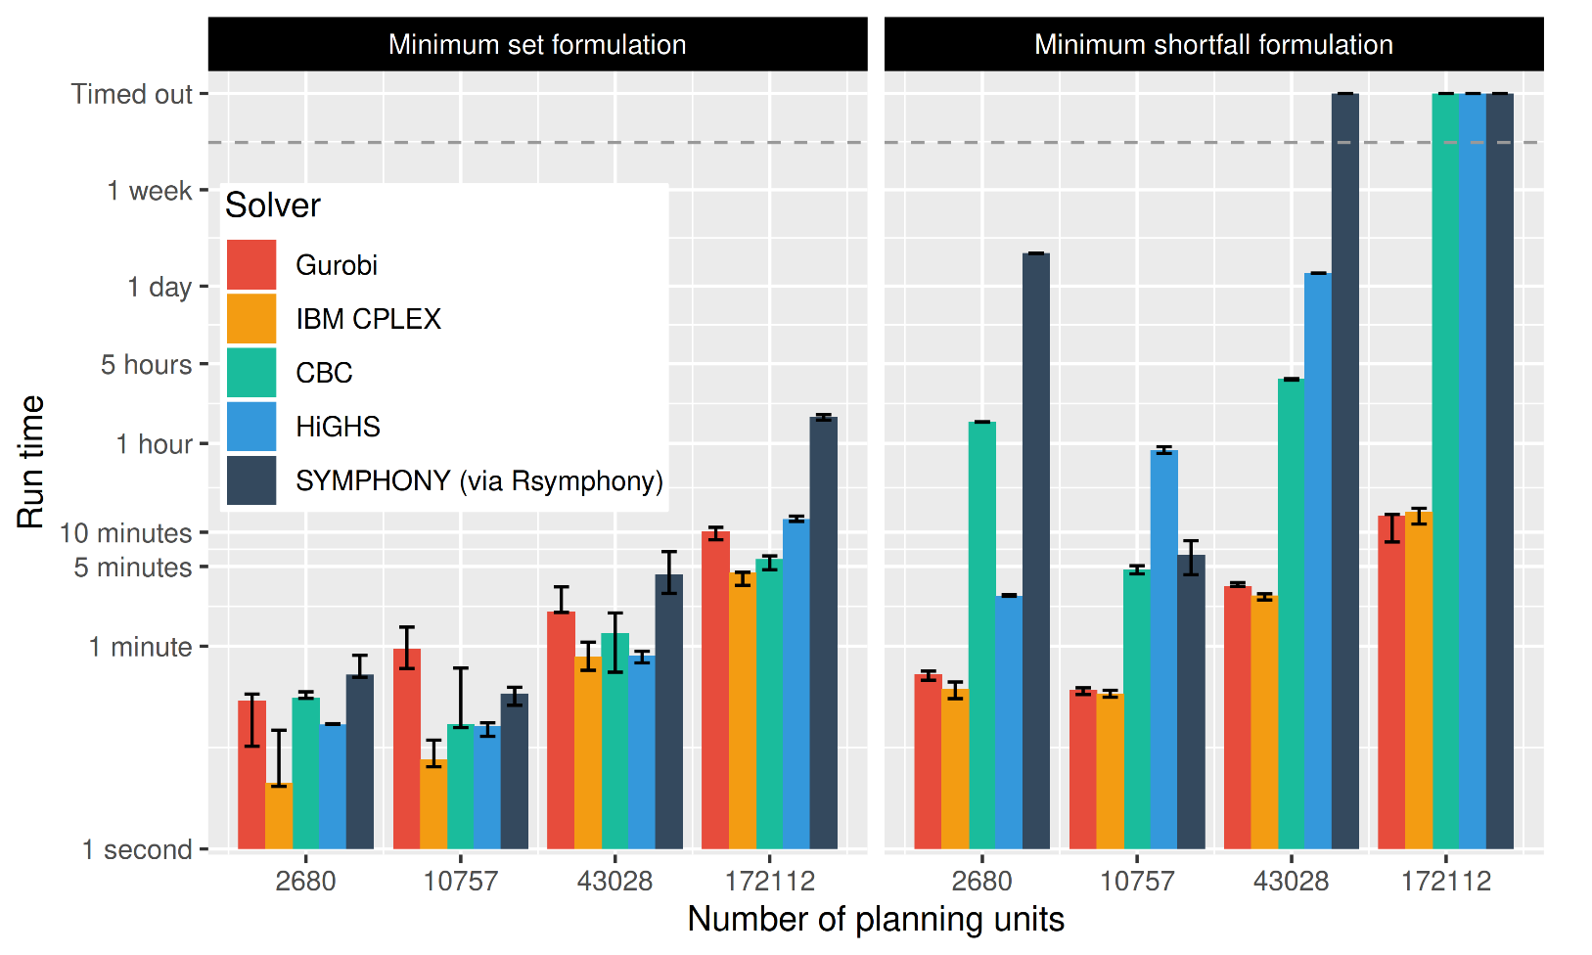
Solve problems pretty quickly!
Notes: 396 features, no planning units locked in or out, prioritizations ≤ 10% from optimality
Hanson et al. under review

Slide 15
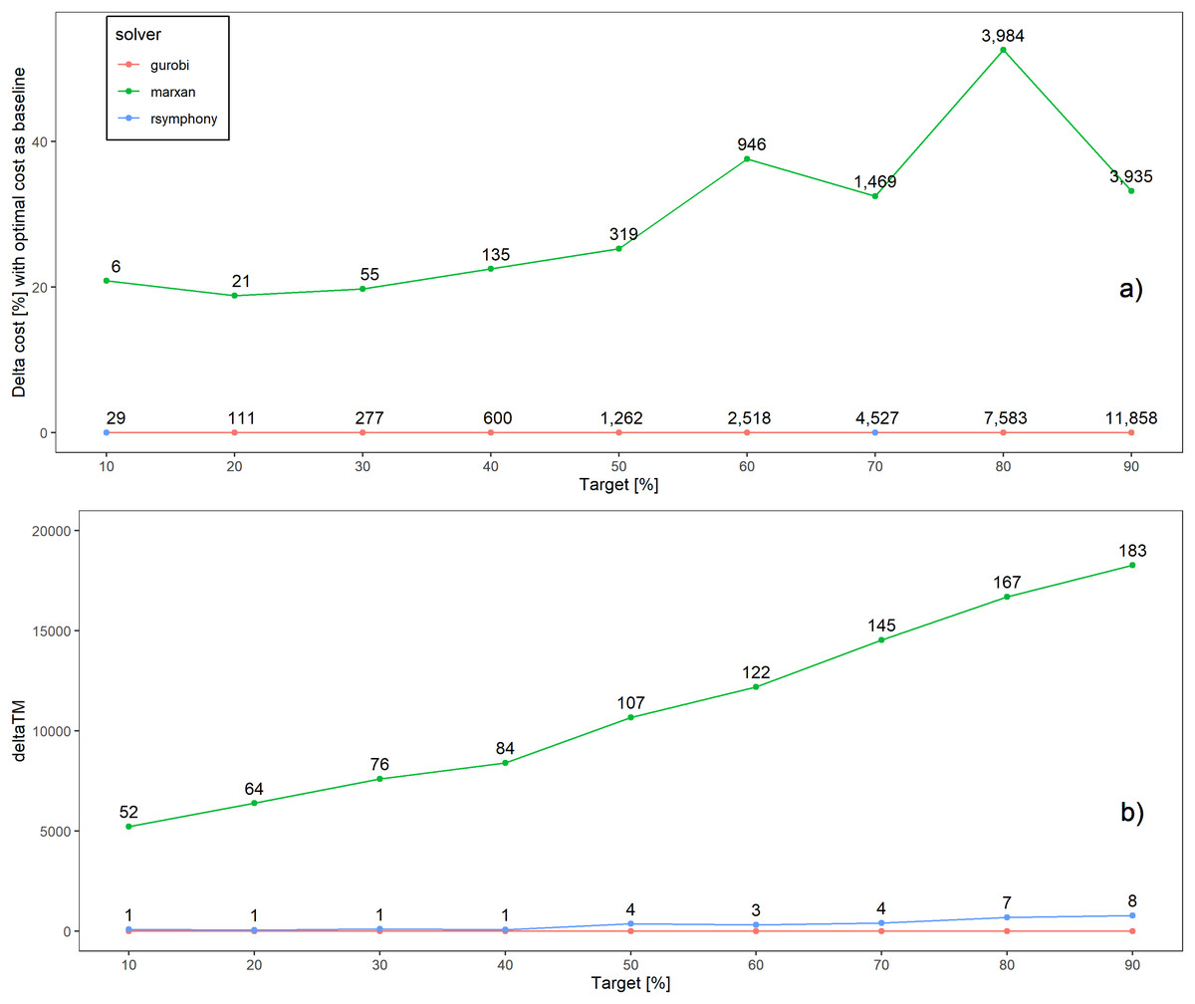
Better solutions
Schuster et al. 2020 PeerJ

Slide 16
Faster too
183x slower
52x slower
Time difference
Schuster et al. 2020 PeerJ

Slide 17
What about other conservation problems?

Slide 18







Feature data
Phylogenetic data
Stakeholder weights
Project prioritization
Project data
Actions
Recovery projects

Slide 19
Feature data
Phylogenetic data
Stakeholder weights
Project prioritization
Project data
Actions
Success
90%
20%
Recovery projects
50%
100%

Slide 20
Feature data
Phylogenetic data
Stakeholder weights
Project prioritization
Project data
Actions
Persistence (%)
Success
90%
95%
20%
10%
Recovery projects
50%
70%
100%
40%
9%
65%

Slide 21
Feature data
Phylogenetic data
Stakeholder weights
Project prioritization
Project data
Cost data
Actions
Persistence (%)
$
Success
$$
90%
95%
$$$
20%
10%
Recovery projects
$0
50%
70%
100%
40%
9%
65%
Budget
$$$

Slide 22
Feature data
Phylogenetic data
Stakeholder weights
Project prioritization
Project data
Cost data
Actions
Persistence (%)
$
Success
$$
90%
95%
$$$
20%
10%
Recovery projects
$0
50%
70%
100%
40%
9%
65%
Budget
$$$

Slide 23
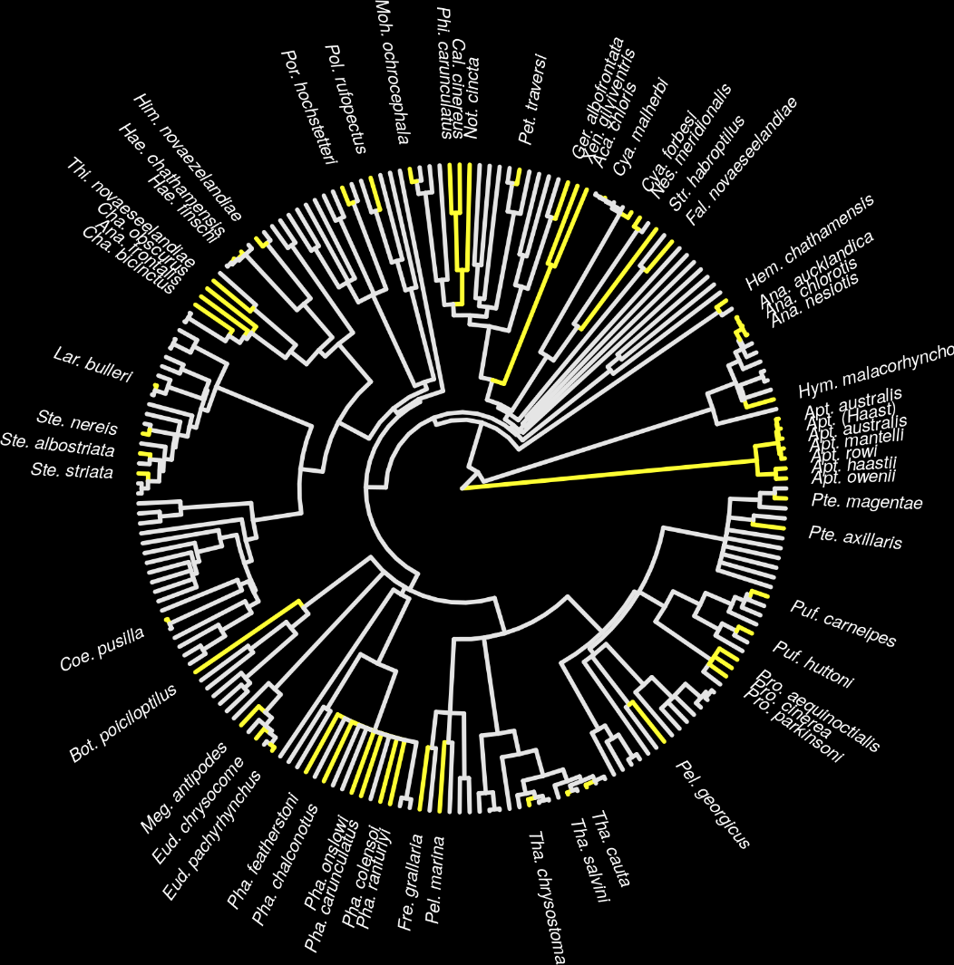
New Zealand case study
Projects for 62 imperiled bird species
1,218 different actions
Many actions shared between projects for different species
Hanson et al. 2019 Methods Ecol Evol

Slide 24
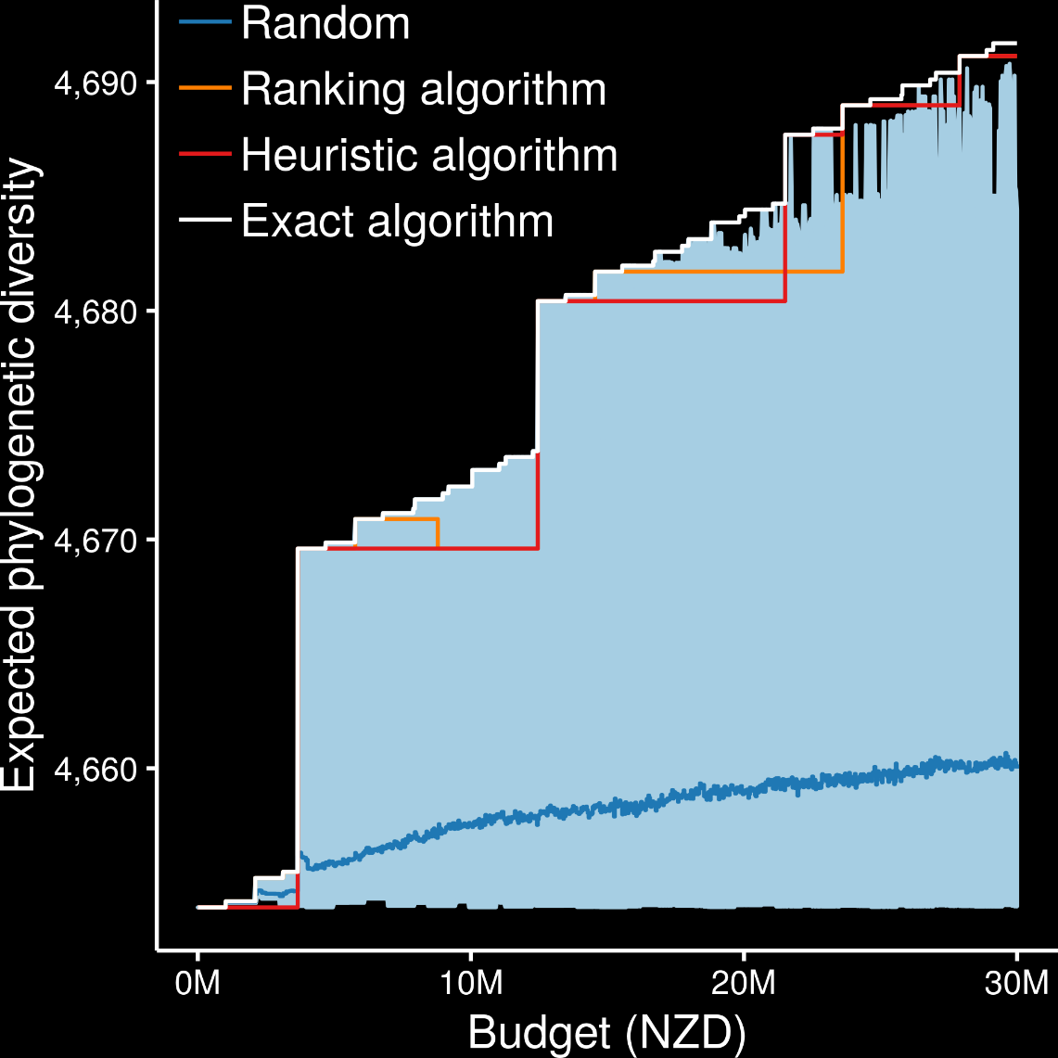
Exact algorithms always best
Ranking and heuristic algorithms sometimes produced optimal plans
Randomly funding projects sometimes produced better plans than ranking and heuristic algorithms
oppr R package
Hanson et al. 2019 Methods Ecol Evol

Slide 25
How can we get a better conservation decision?
(1) Better algorithms
(2) Better data
(3) Better surrogates

Slide 26
Ecological surveys
Distribution maps
Priority areas
Biodiversity
2000
Future
Data
Information
Plan
Outcome
Objectives
Constraints
Notes:
26

Slide 27

Ecological surveys
Distribution maps
Priority areas
Biodiversity
2000
Future
Data
Information
Plan
Outcome
Better
understanding
of biodiversity
Better
plan
Better
outcome
Genetic samples
Objectives
Constraints
Notes:
27

Slide 28
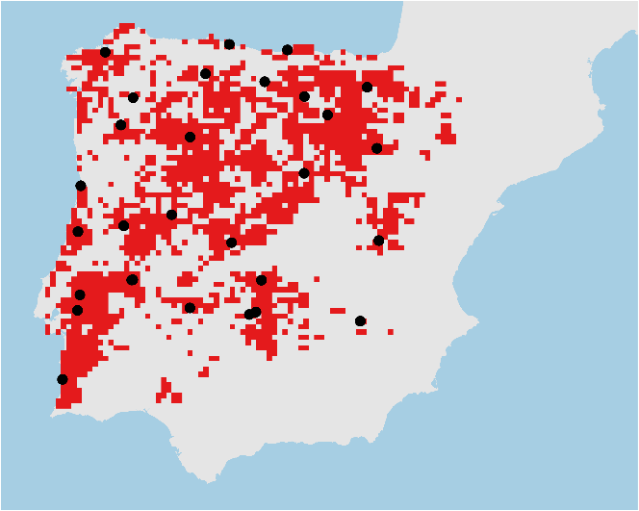
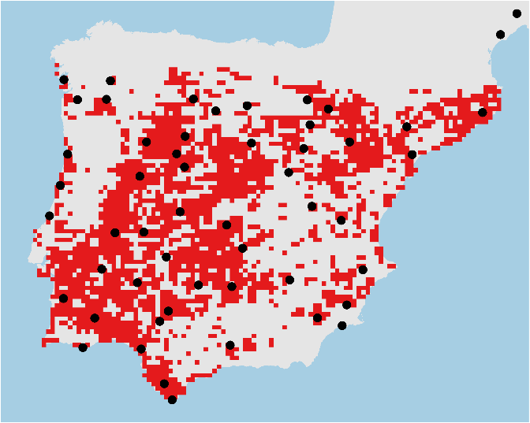
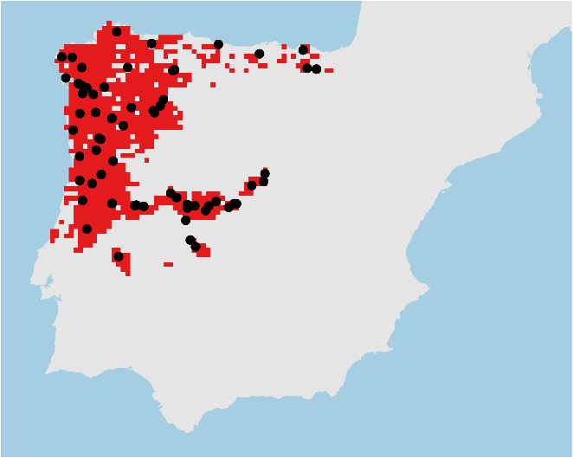

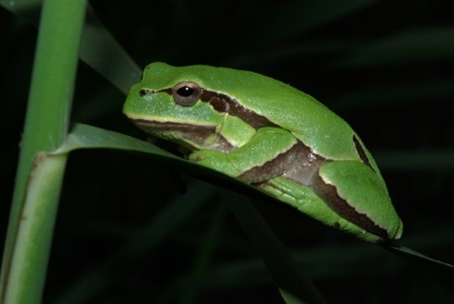
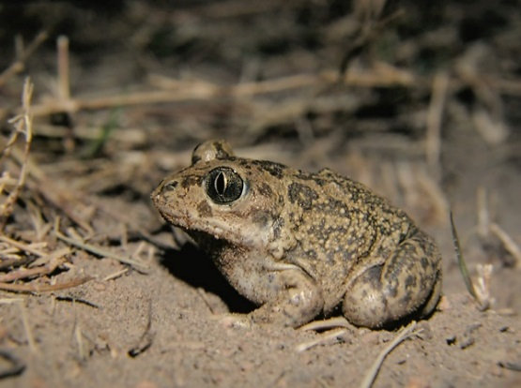
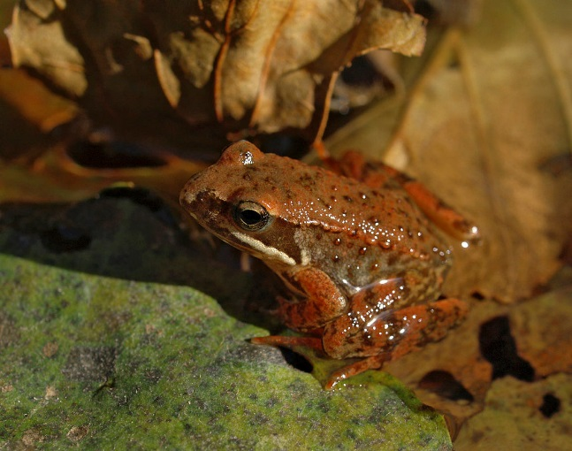
Conservation planning for adaptive and neutral evolutionary processes
Hyla molleri
Pelobates cultripes
Rana iberica

Slide 29
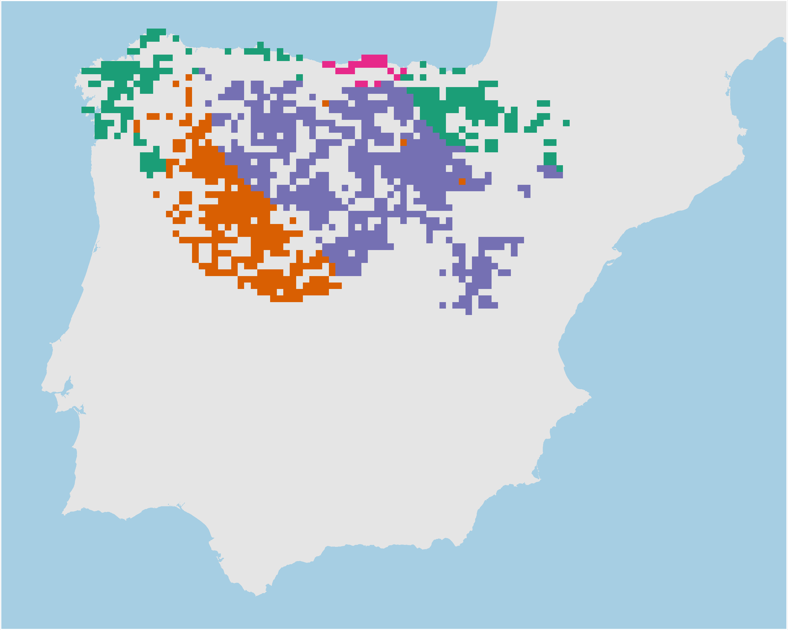
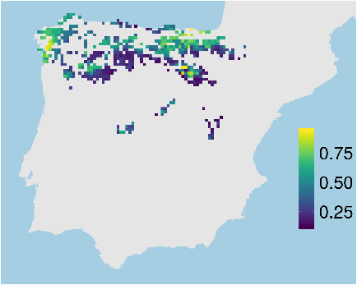
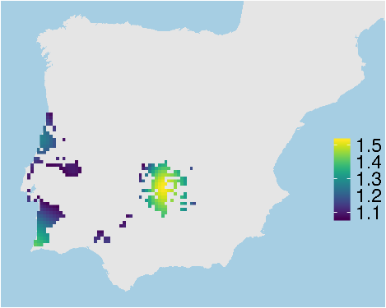
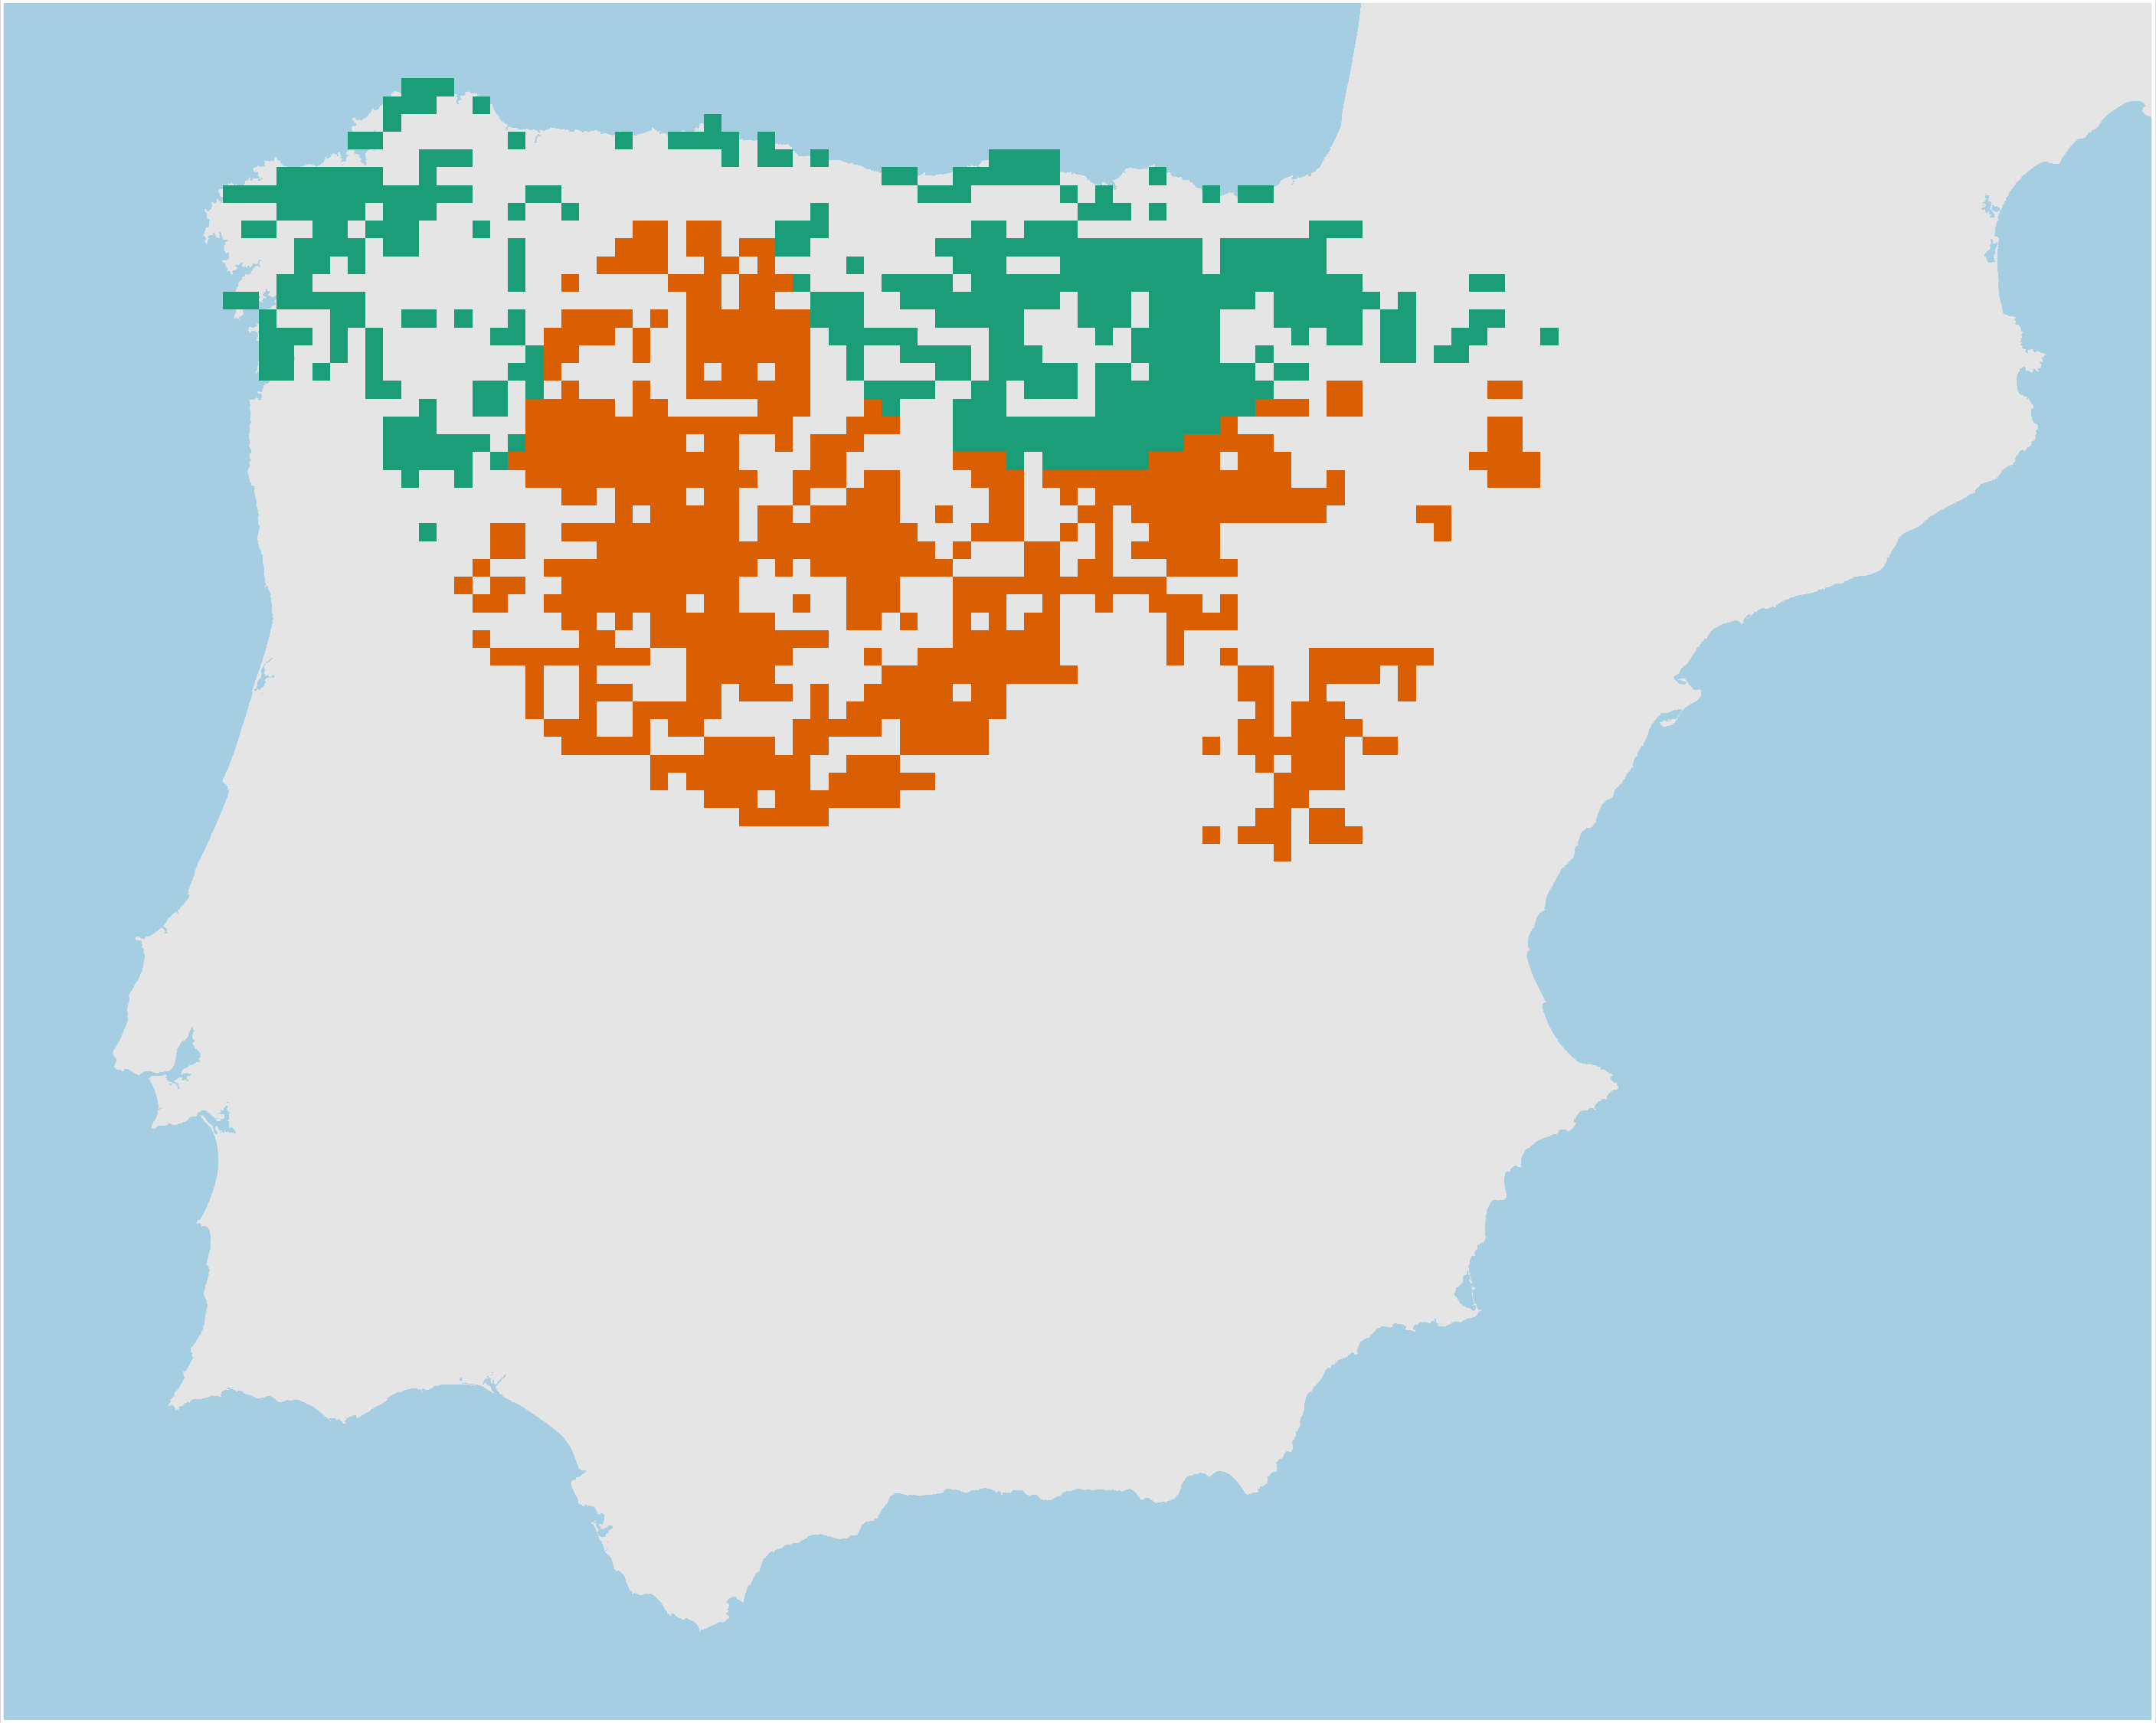
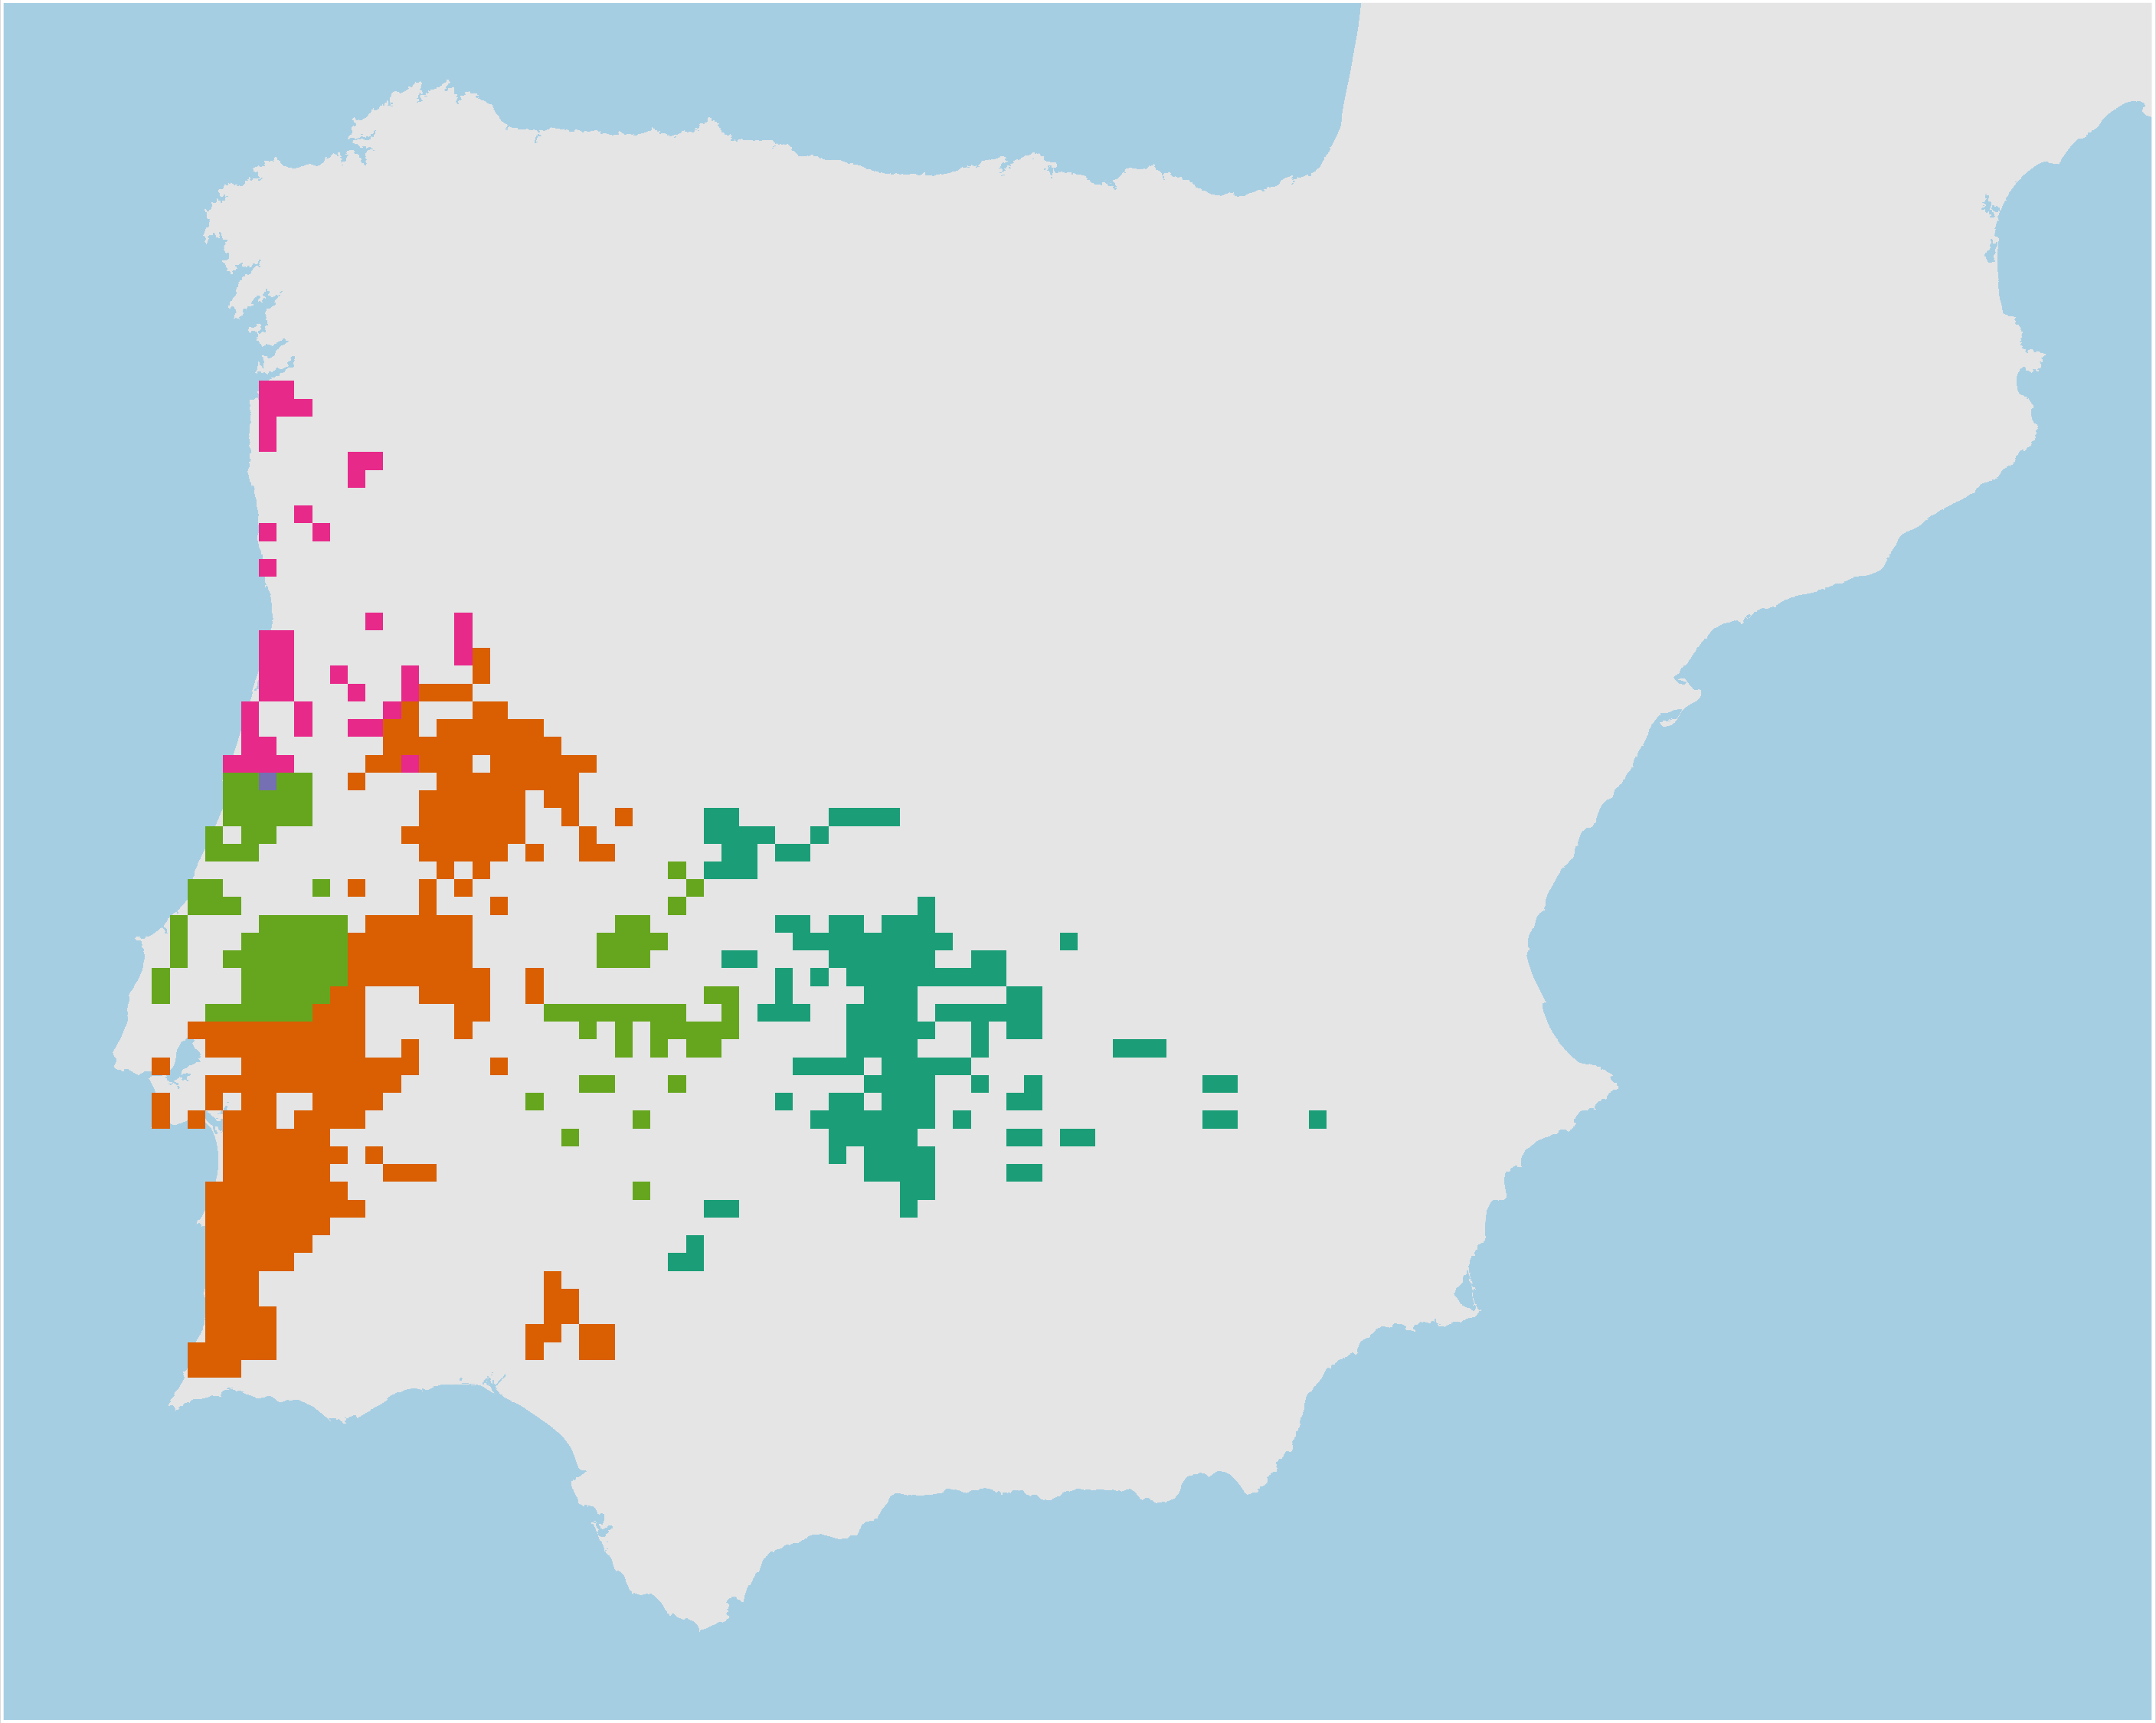
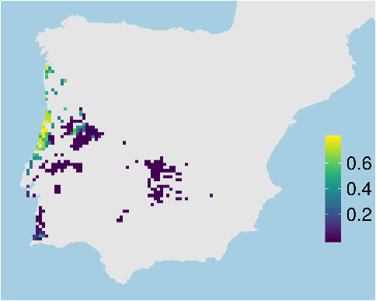
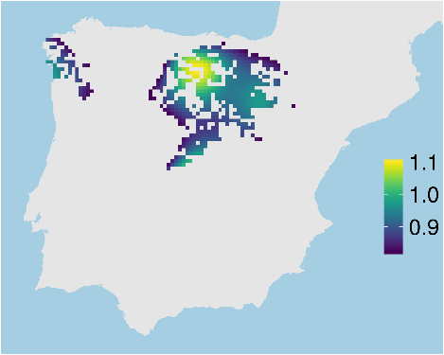
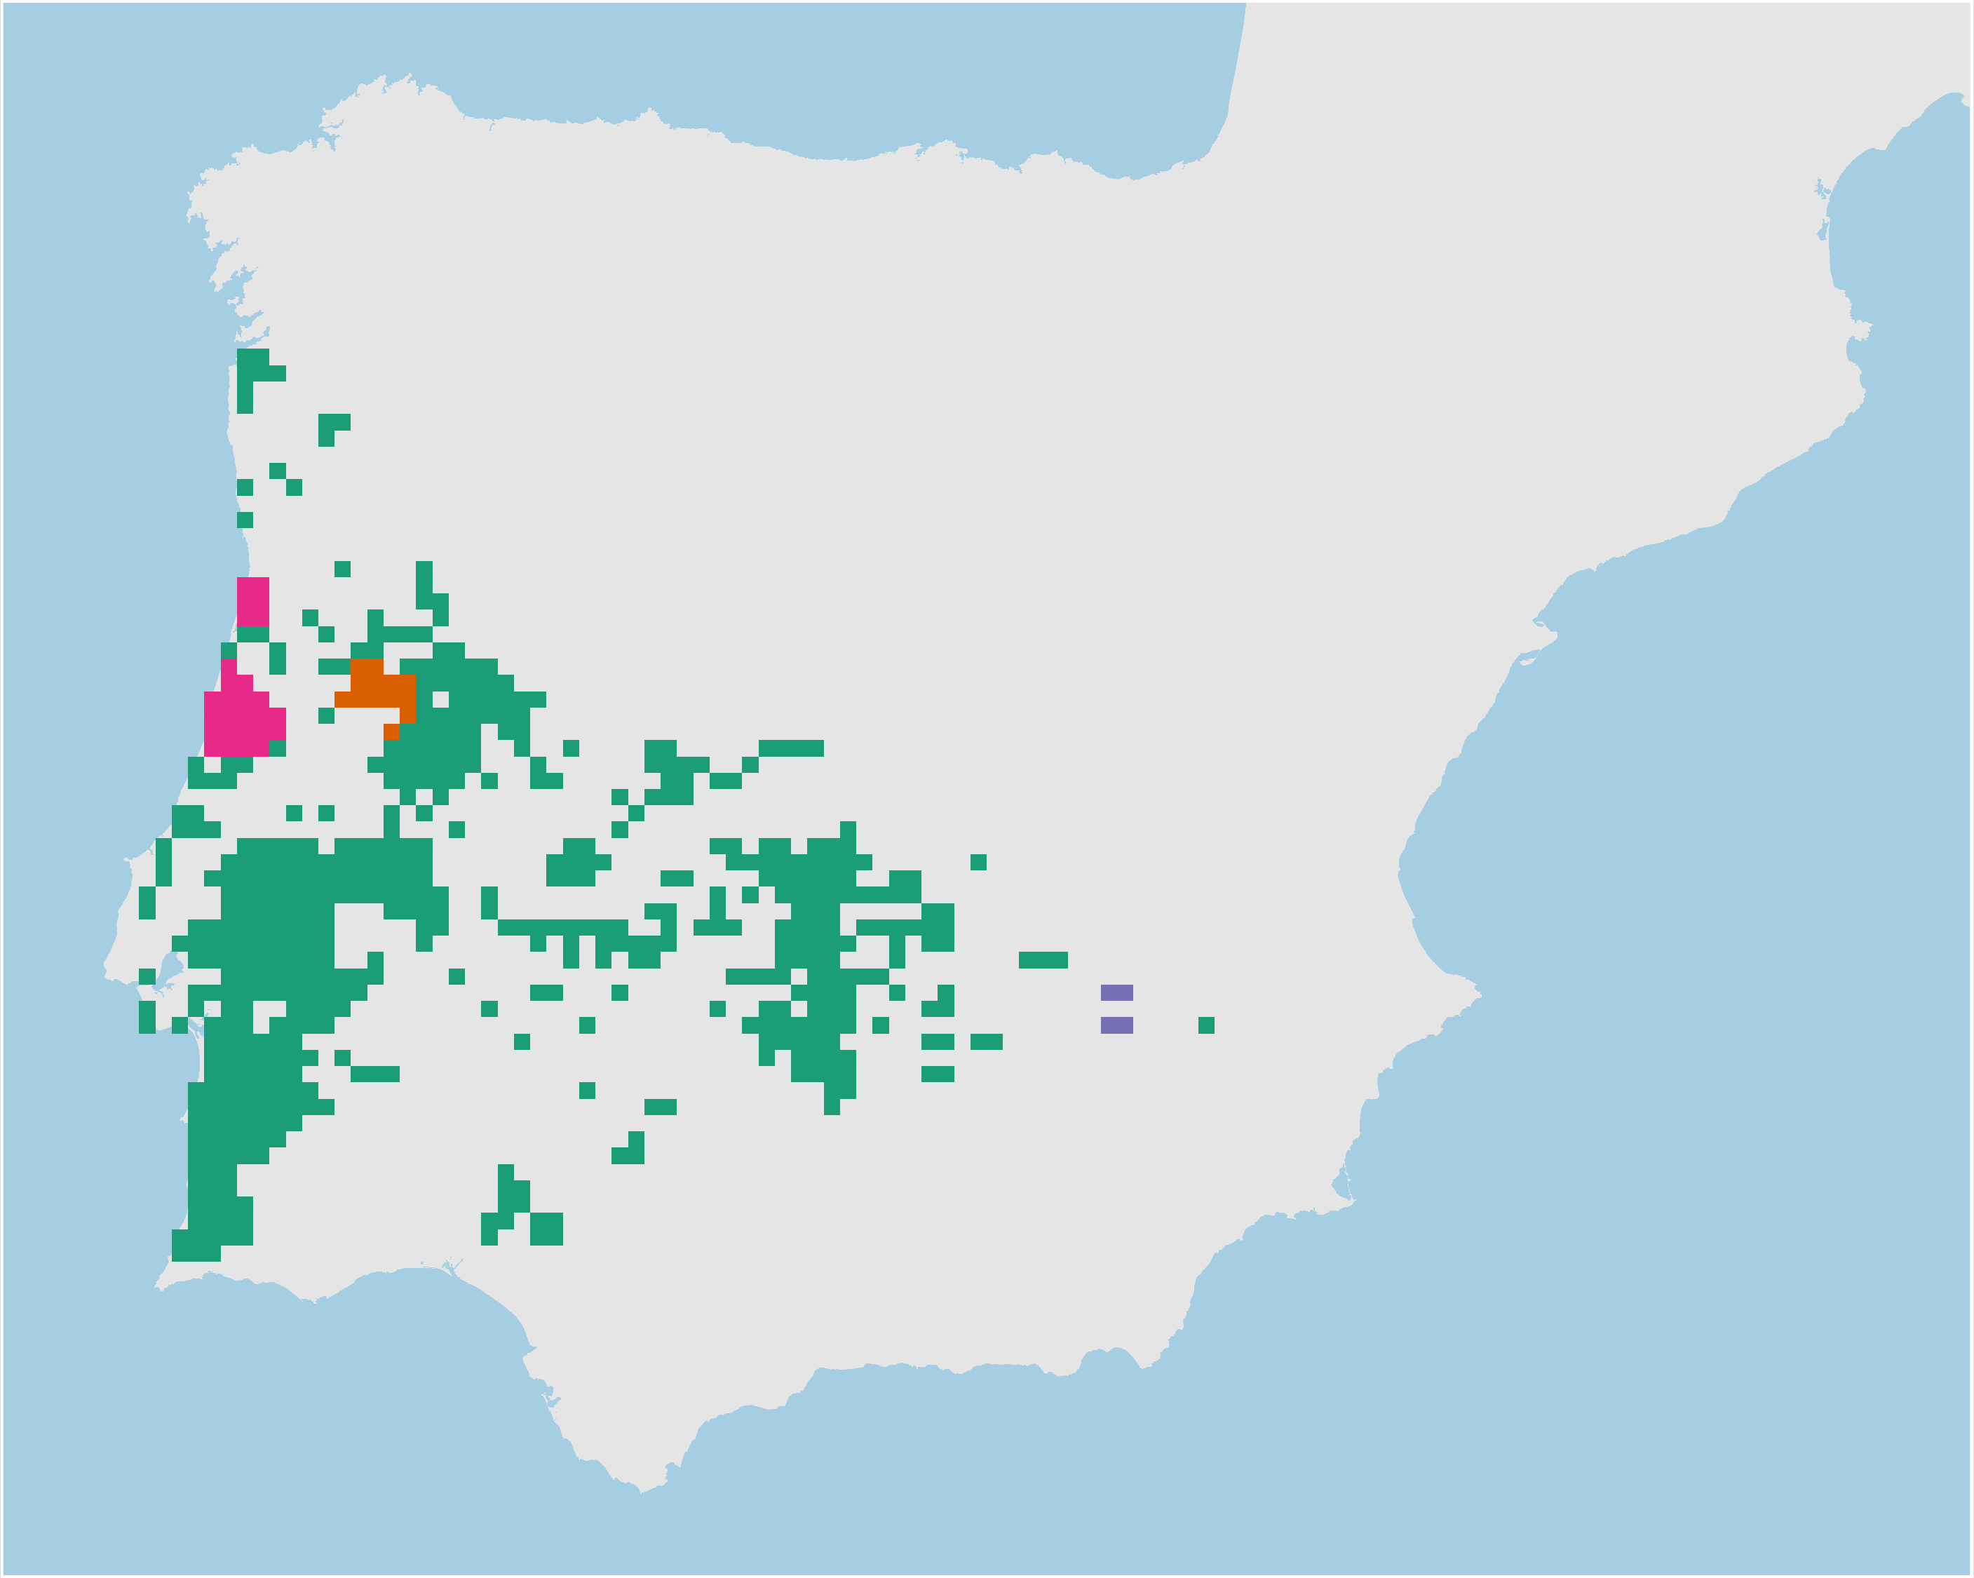
Adaptive processes
Neutral processes
Hyla molleri
Adaptive
clusters
Climate
refugia
Individual
heterozygosity
Neutral
clusters

Slide 30
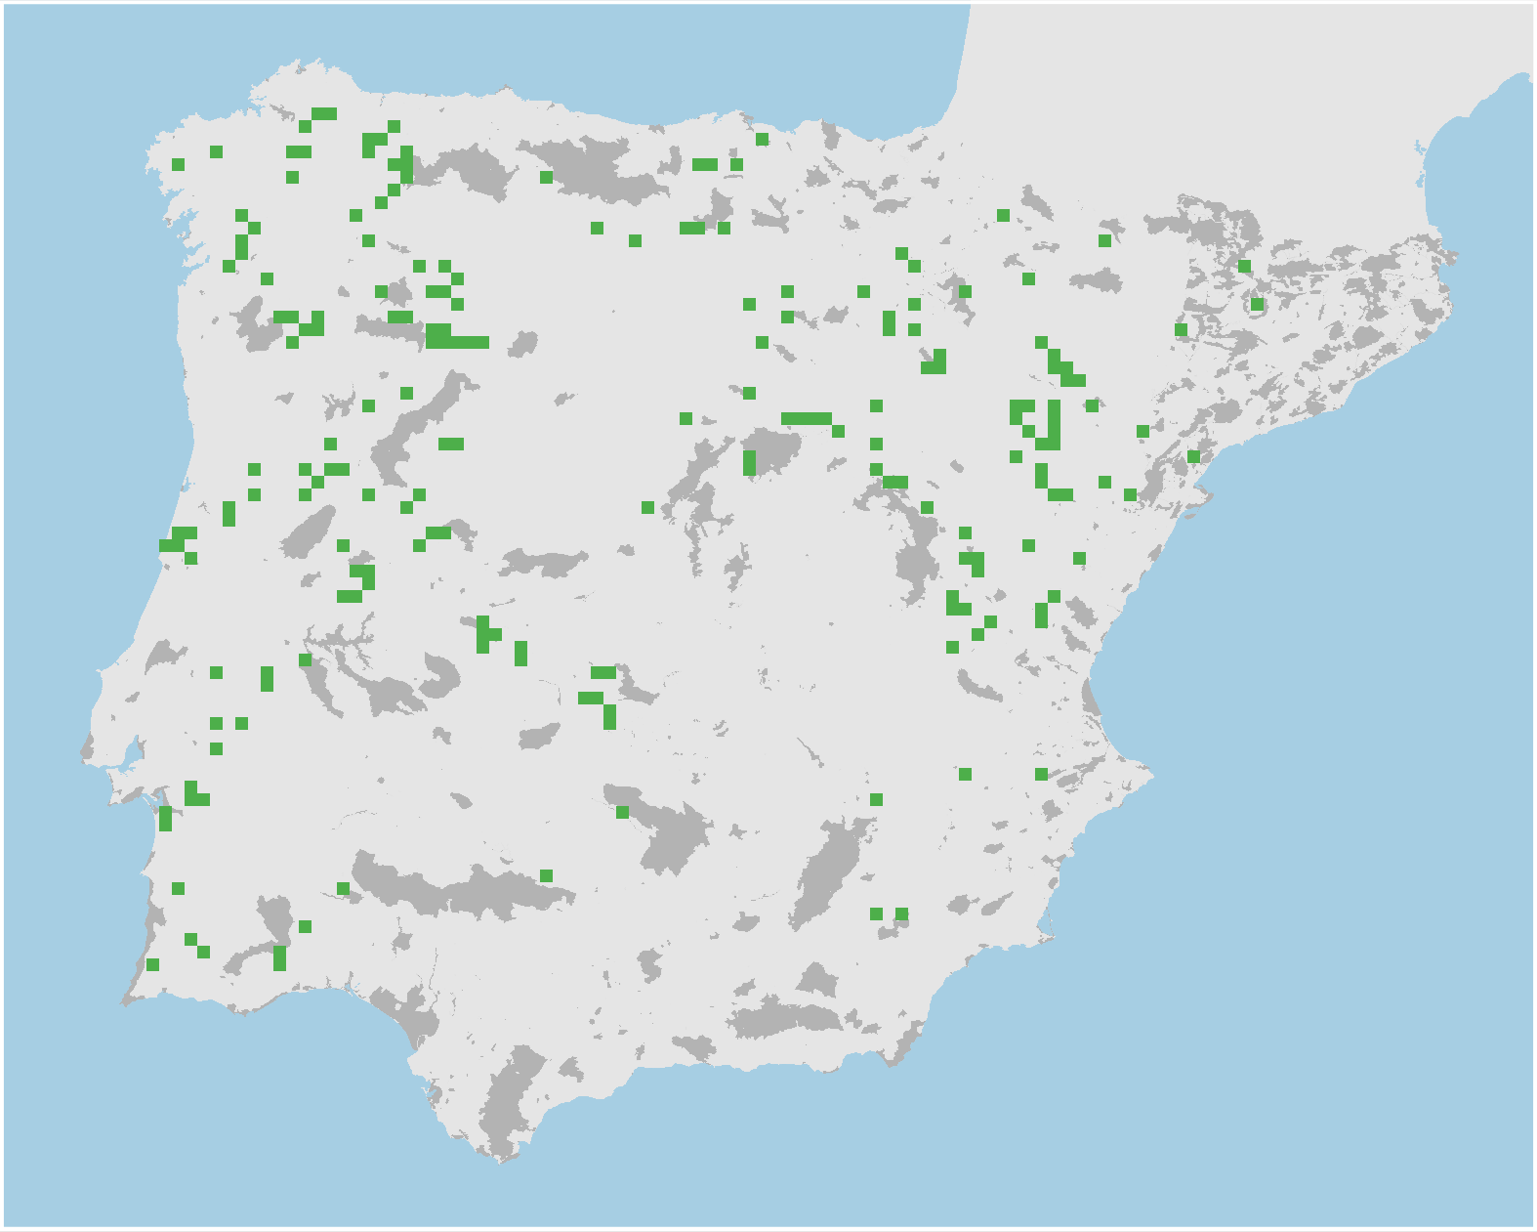
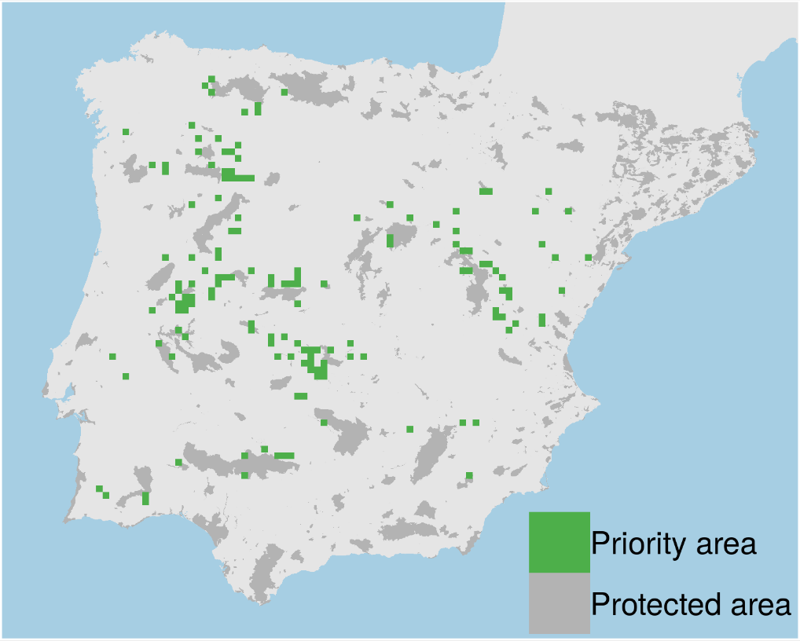
Prioritizations
Plan with evolutionary
attributes
Conventional plan
Only costs 9% less

Slide 31
However, more data isn’t always better…

Slide 32
Ecological surveys
Distribution maps
Priority areas
Biodiversity
2000
Future
Data
Information
Plan
Outcome
Objectives
Constraints

Slide 33
Ecological surveys
Distribution maps
Priority areas
Biodiversity
?
?
?
?
?
?
2000
Future
Data
Information
Plan
Outcome
More
surveys
Better
models
Better
management
Better
outcome
Objectives
Constraints

Slide 34
Ecological surveys
Distribution maps
Priority areas
Biodiversity
?
?
?
?
?
?
?
?
?
?
?
?
2000
Future
Data
Information
Plan
Outcome
More
surveys
Better
models
Poorer
management
Worse
outcome
Objectives
Constraints
Less funding

Slide 35
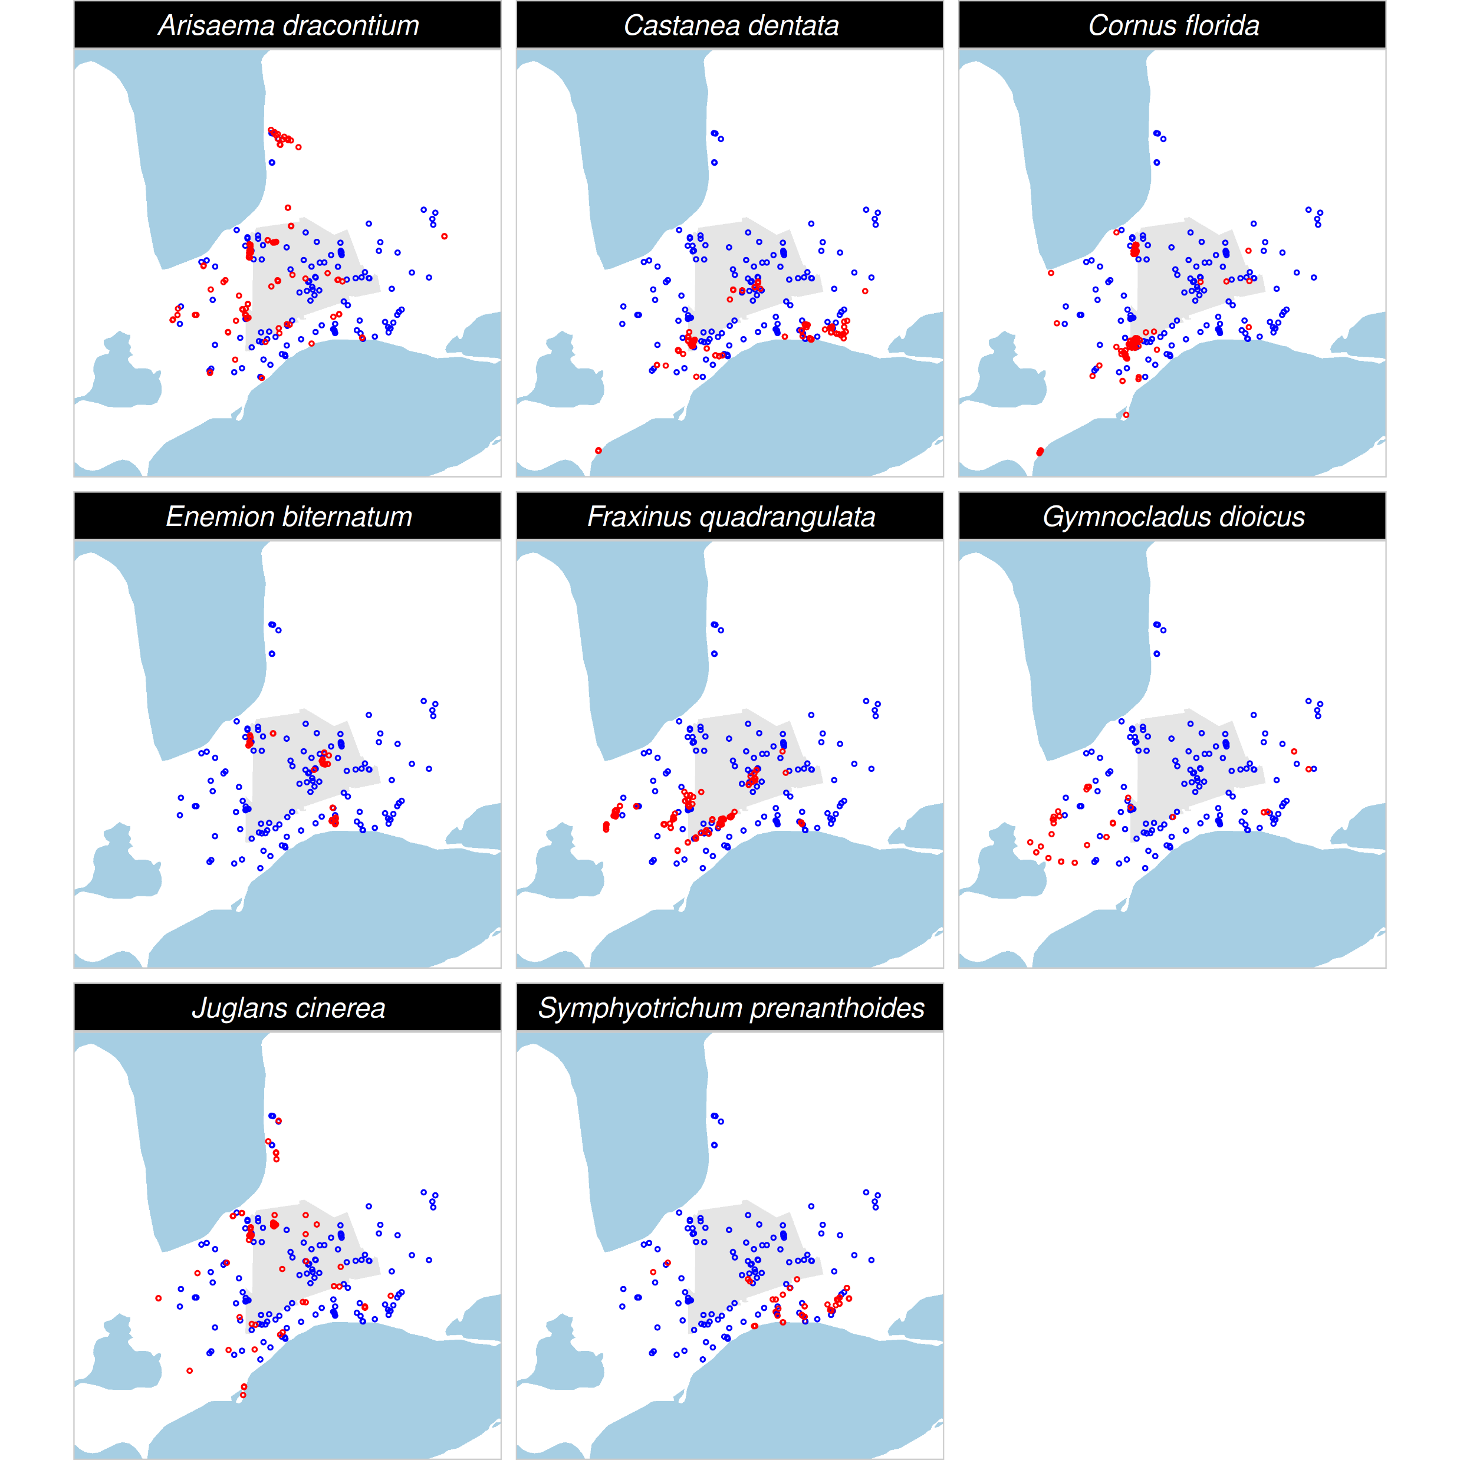
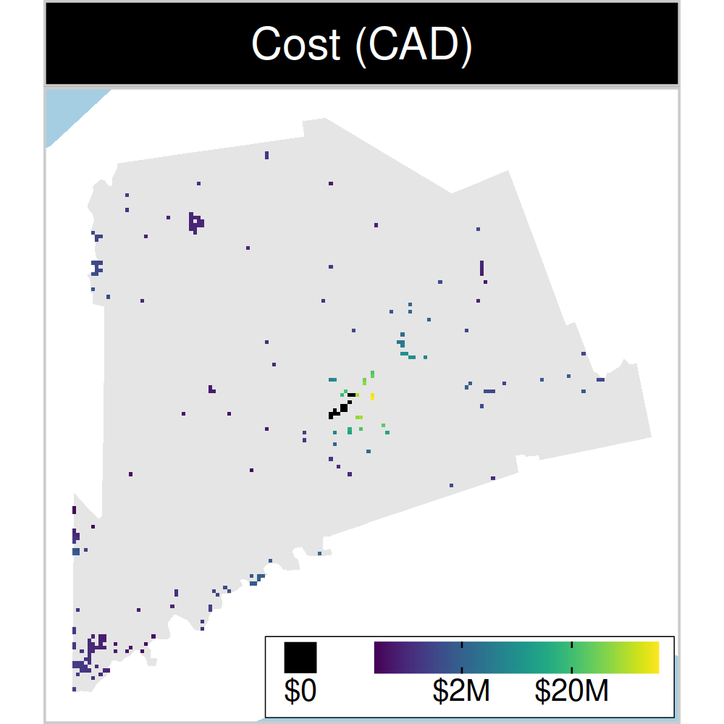
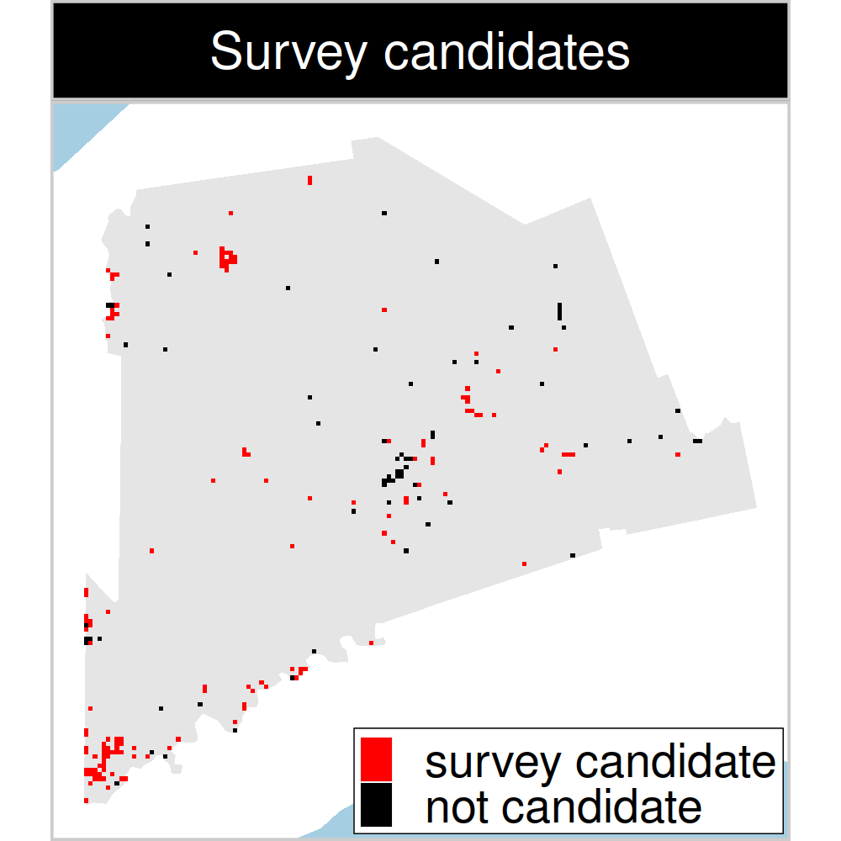
Study system: Middlesex county, Canada
199 places that could
potentially be acquired for
protected area establishment
143 places that could potentially be surveyed to
improve existing data
8 imperiled plant species
Hanson et al. 2022 J. Appl. Ecol
Notes:
35

Slide 36
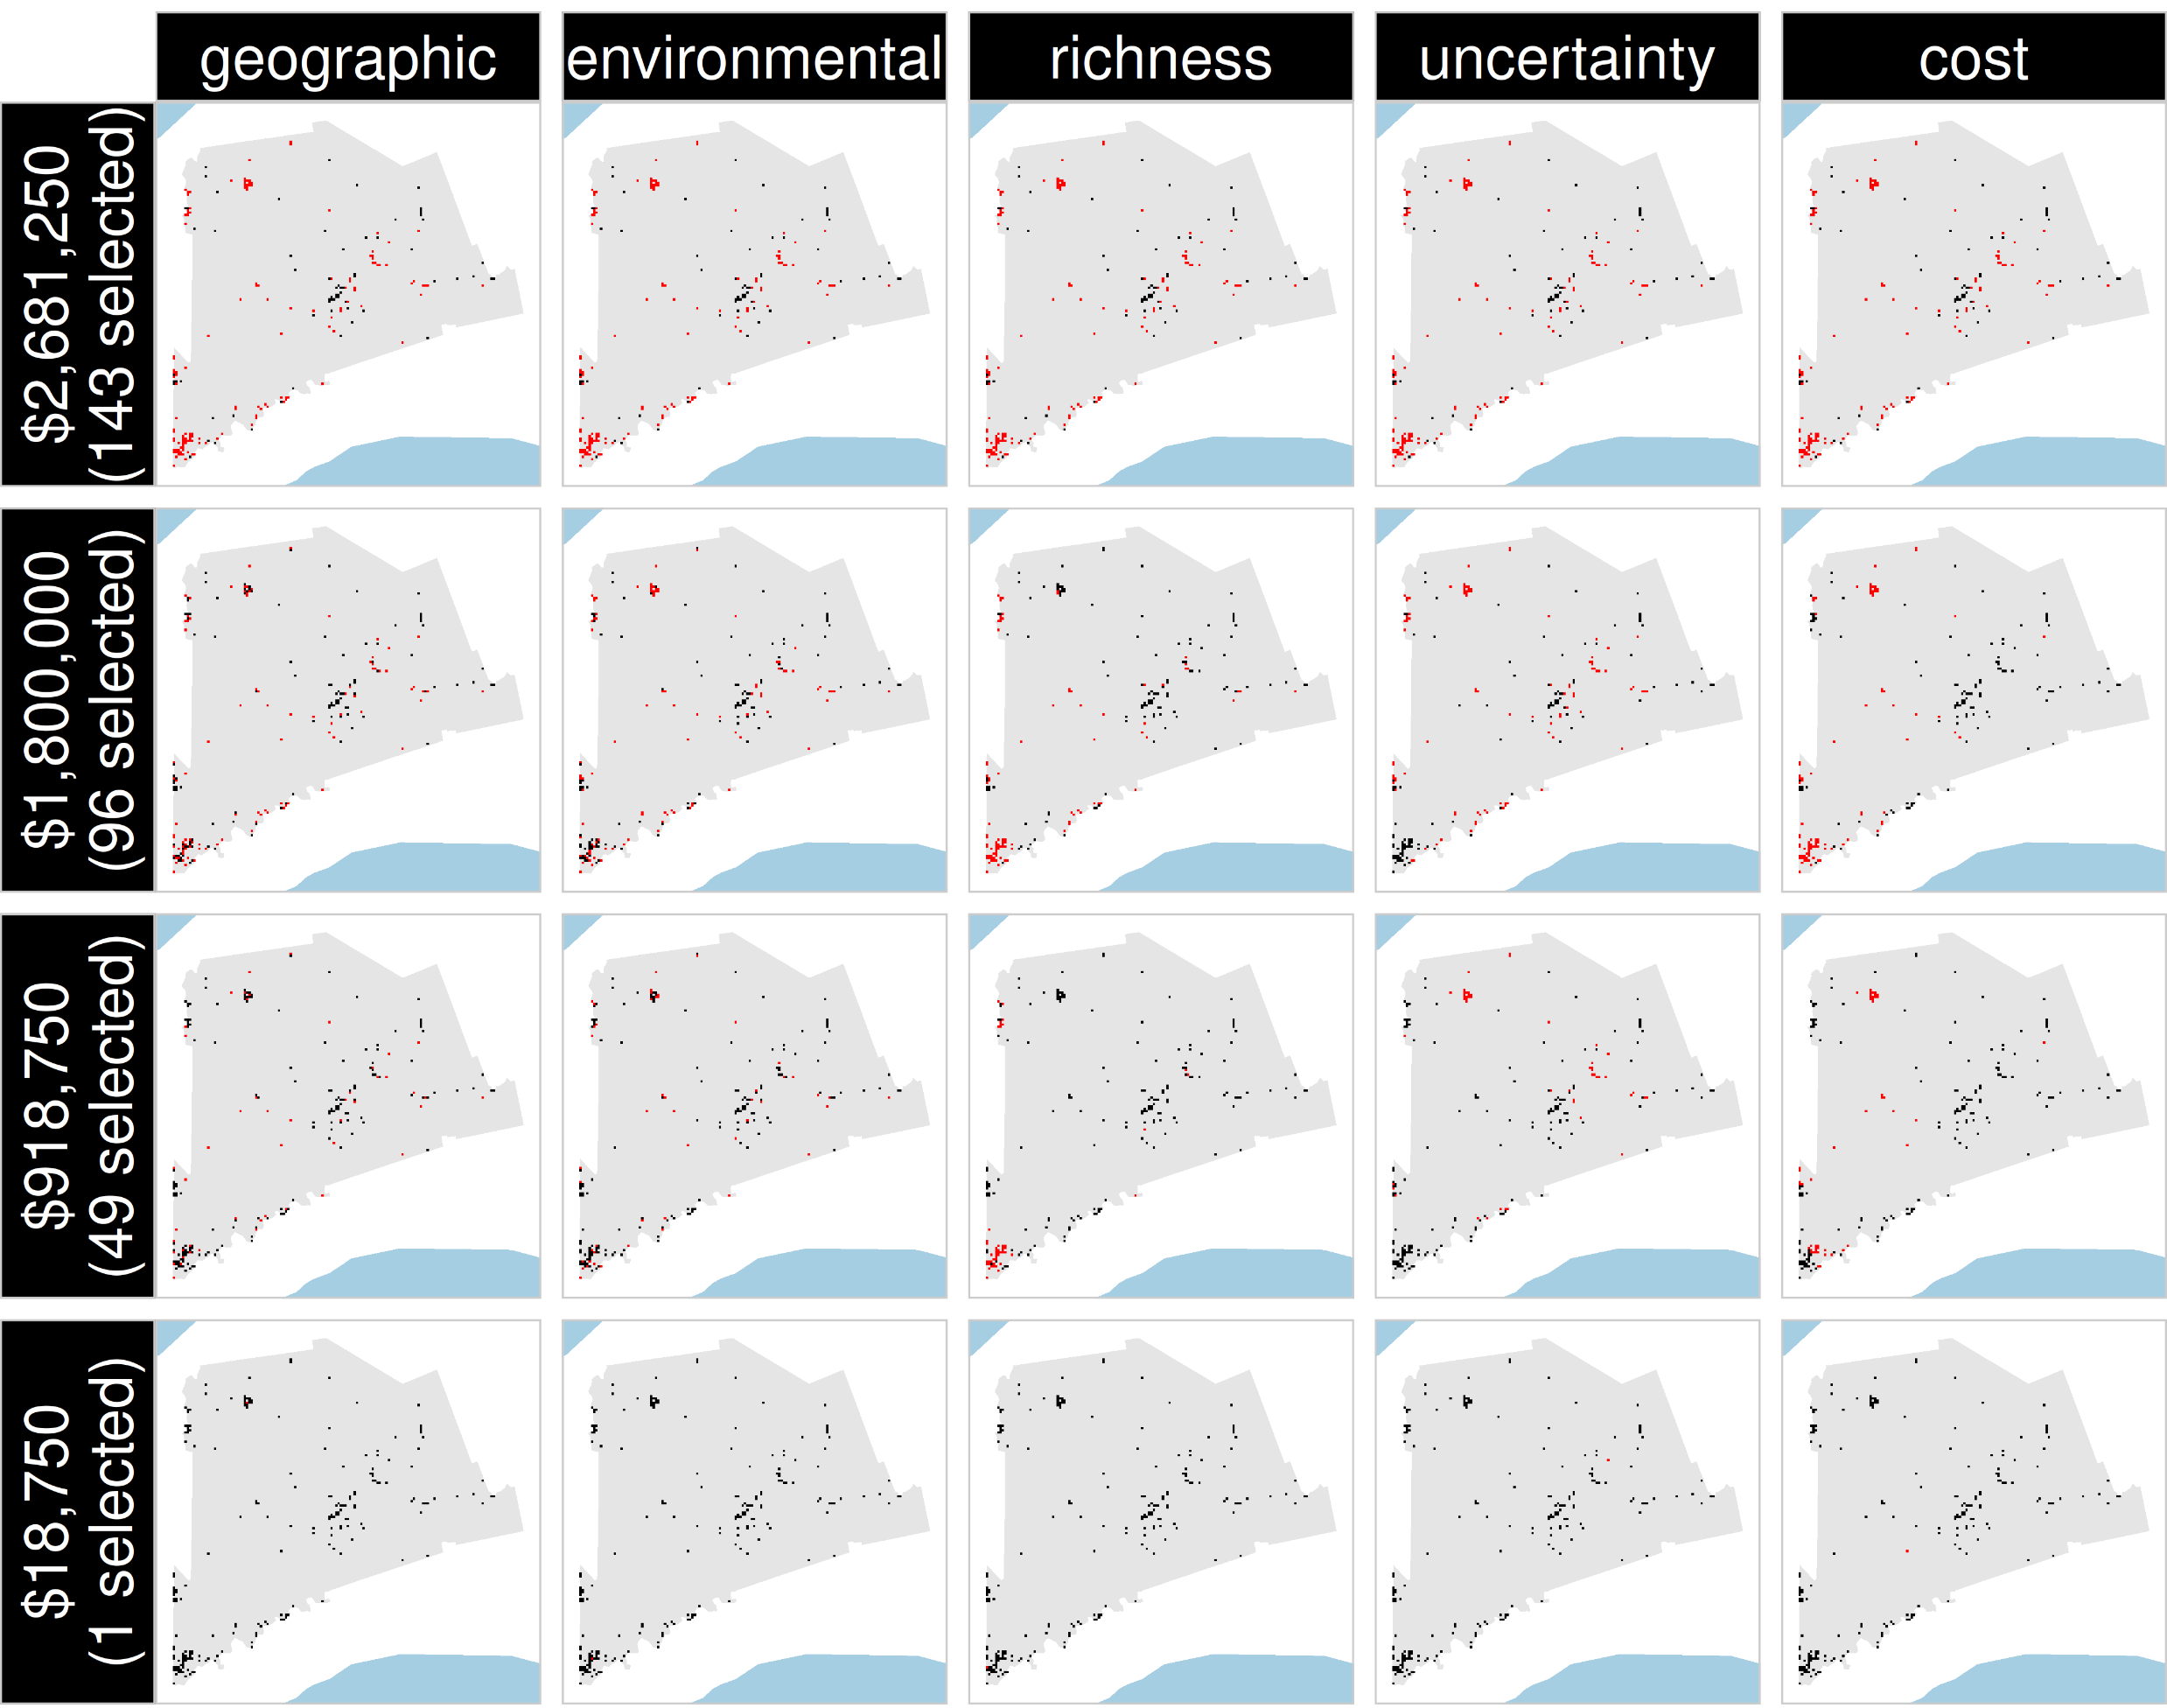
Selected
for survey
Number of places selected for surveys
(amount of funds allocated for collecting extra data)
NOT selected
for survey
Different approaches for designing survey schemes
Hanson et al. 2022 J. Appl. Ecol

Slide 37
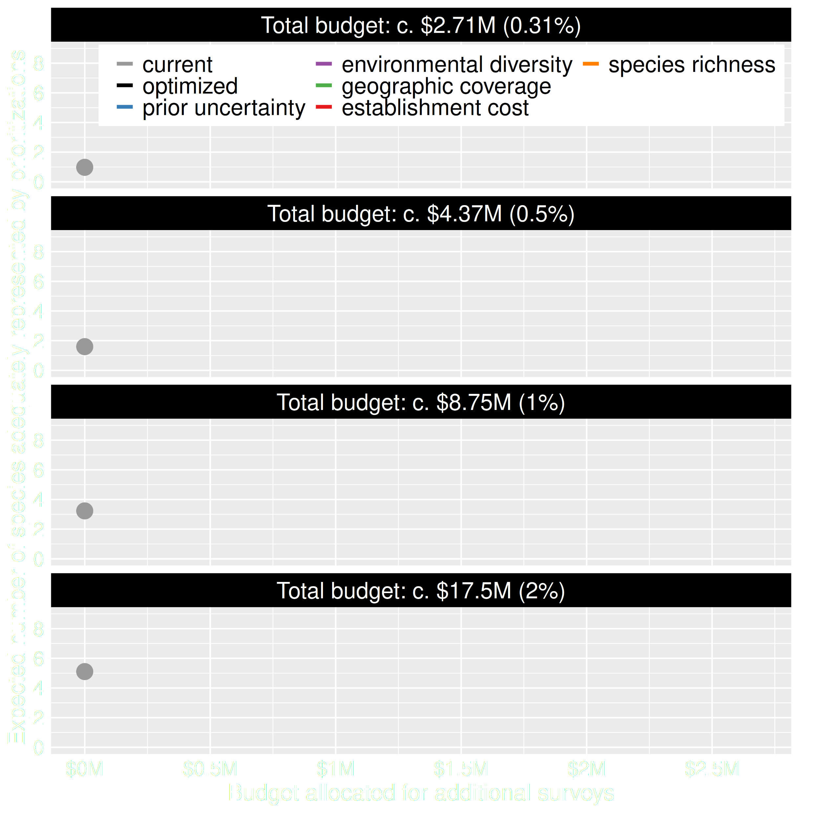
Value of information
Existing data leads to positive outcomes
More budget means better outcomes
Hanson et al. 2022 J. Appl. Ecol

Slide 38
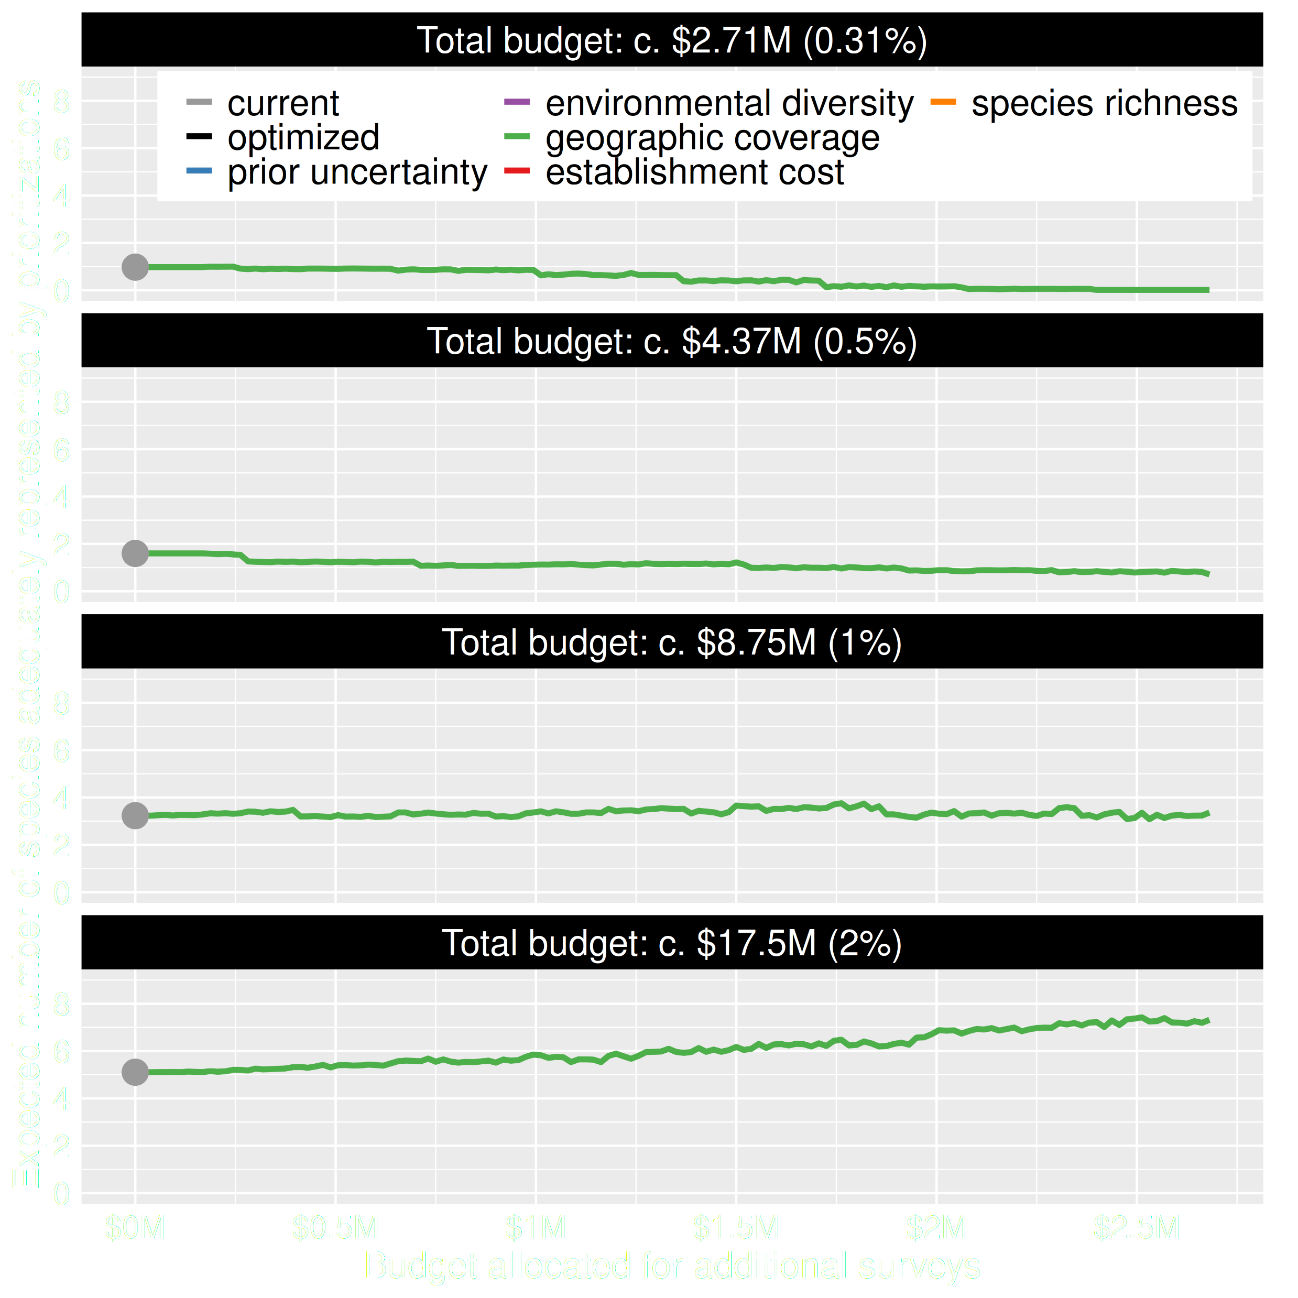
Value of information
Allocating funds for gathering more data can mean worse outcomes
Allocating funds for gathering more data can mean better outcomes too
Hanson et al. 2022 J. Appl. Ecol

Slide 39
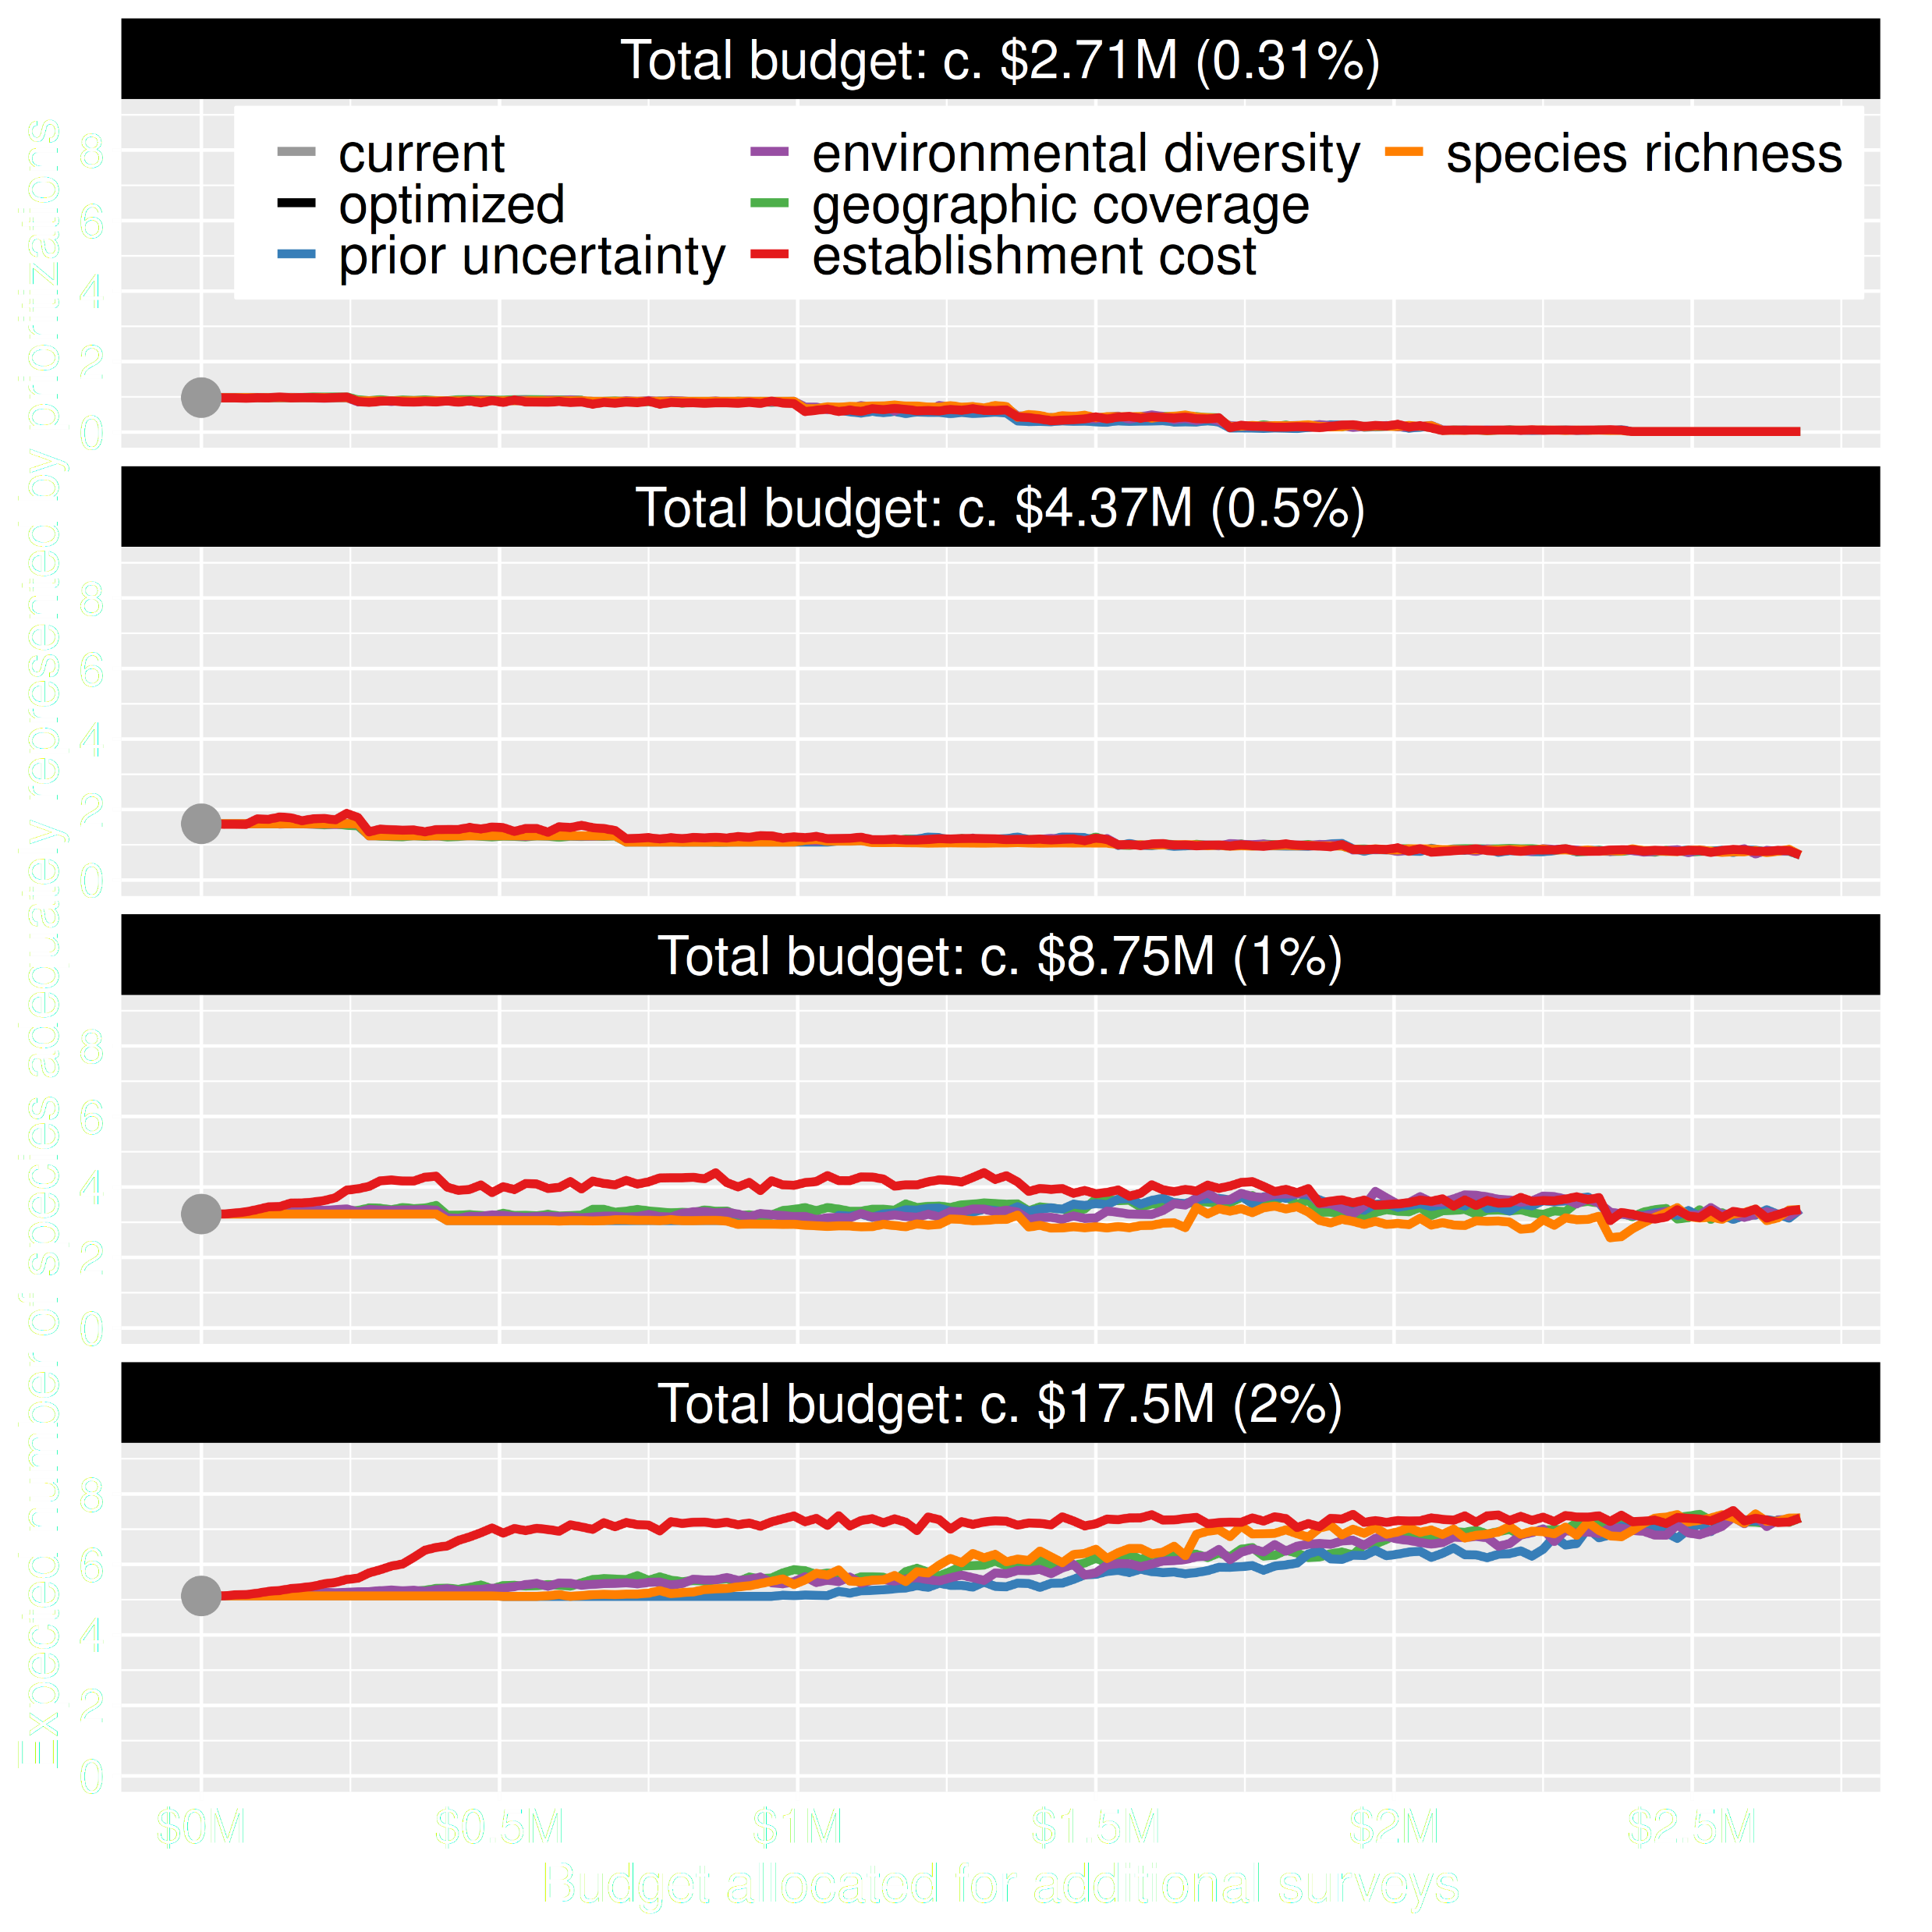
Value of information
Conventional approaches for gathering additional evidence have different performance
Performance of these approaches depends on available funds
All of them could lead to lead to worse outcomes
Hanson et al. 2022 J. Appl. Ecol

Slide 40
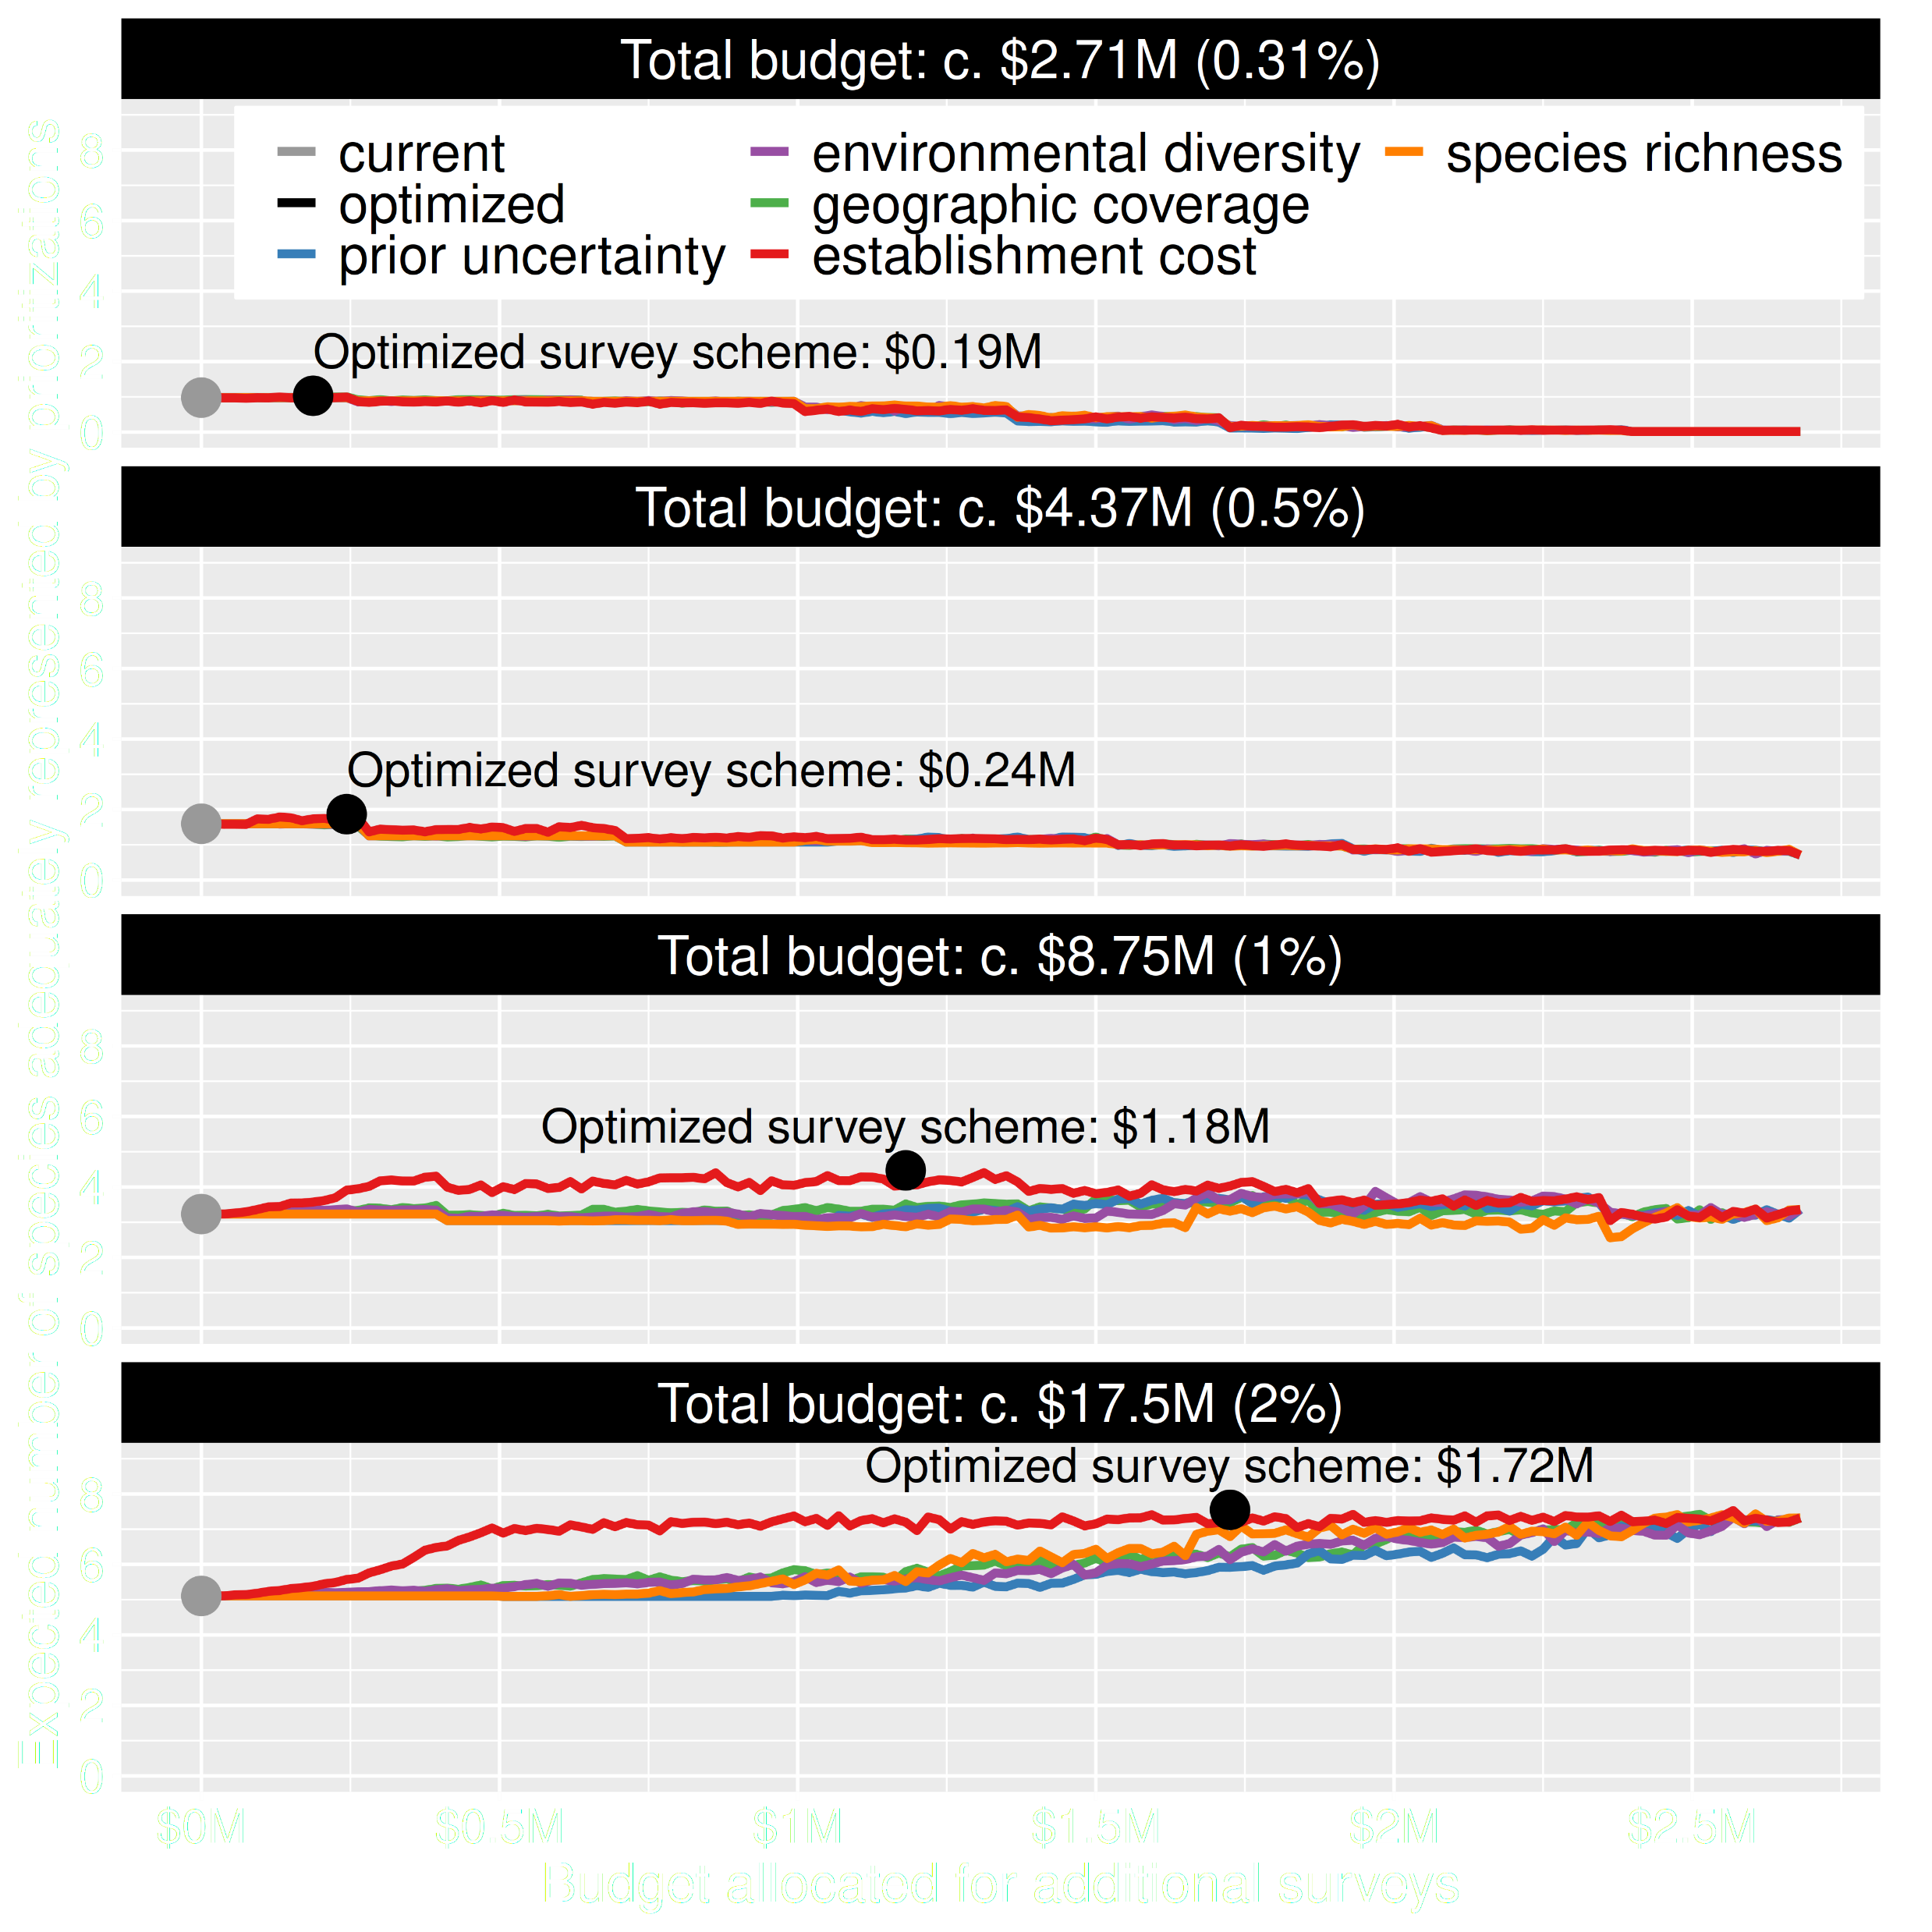
Value of information
Directly maximizing return on investment is best method for additional data
This considers objectives and constraints that underpin conservation plans and their success
Hanson et al. 2022 J. Appl. Ecol

Slide 41
How can we get a better conservation decision?
(1) Better algorithms
(2) Better data
(3) Better surrogates

Slide 42
Evolutionary processes
Species range
Population

Slide 43
Evolutionary processes
Species range
Population

Slide 44
Evolutionary processes
Species range
Population

Slide 45
Evolutionary processes
Species range
Population

Slide 46
Ecological surveys
Distribution maps
Priority areas
Biodiversity
2000
Future
Data
Information
Plan
Outcome
Better
understanding
of biodiversity
Better
plan
Better
outcome
Genetic samples
Objectives
Constraints
Notes:
46

Slide 47
Ecological surveys
Distribution maps
Priority areas
Biodiversity
2000
Future
Data
Information
Plan
Outcome
Good enough
understanding
of biodiversity
Better
plan
Better
outcome
Environment data
Hot
Objectives
Constraints
Cold
Notes:
47

Slide 48
Can we use environmental and geographic variables as surrogates of genetic variation for conservation planning?

Slide 49
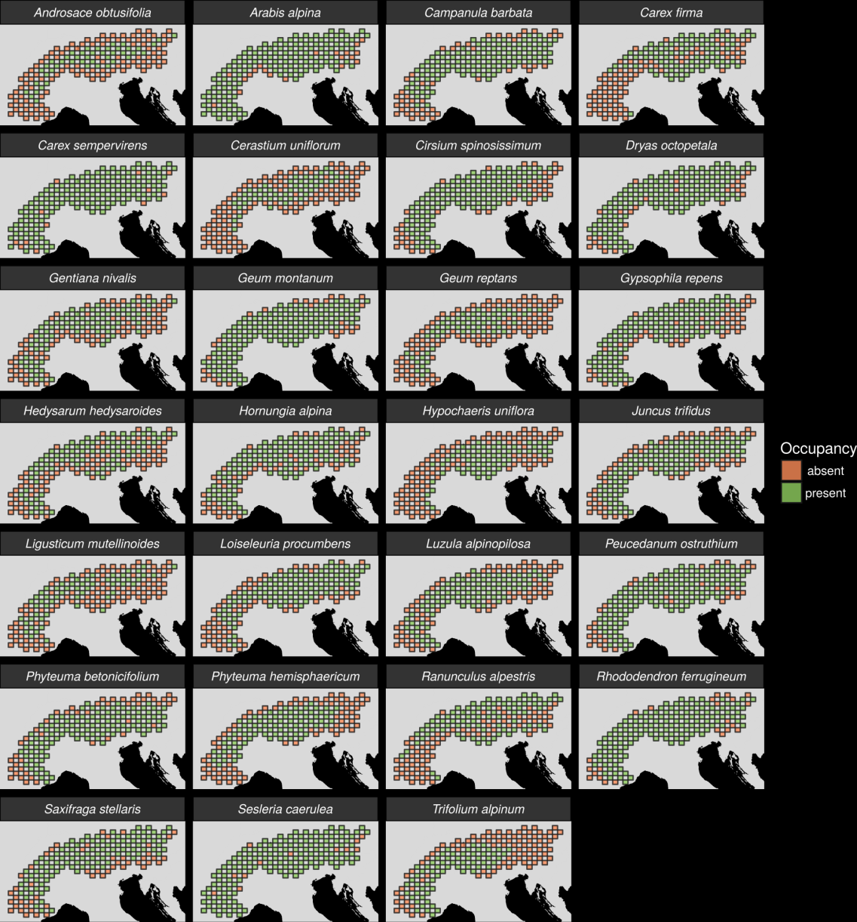
27 plant species
Different dispersal
Different life-histories
Different niches
AFLP markers
Hanson et al. 2017 PNAS

Slide 50
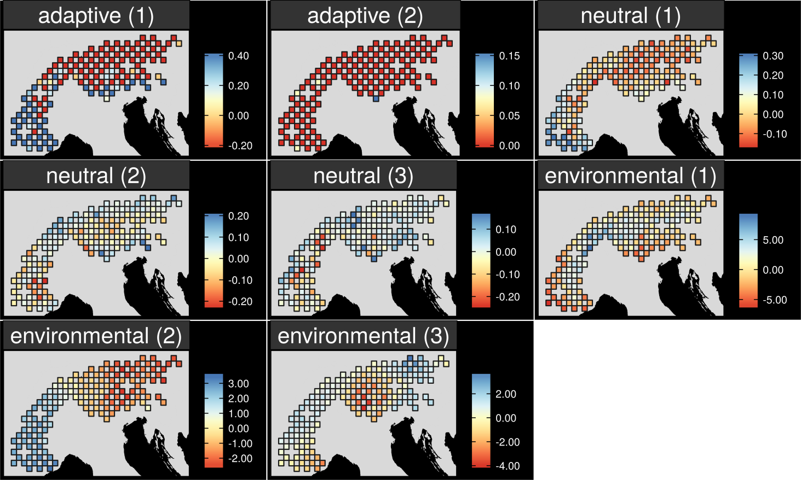
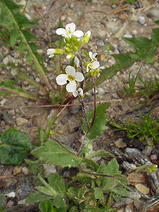
Map intra-specific variation
Arabis alpina
Hanson et al. 2017 PNAS
Notes:
50

Slide 51
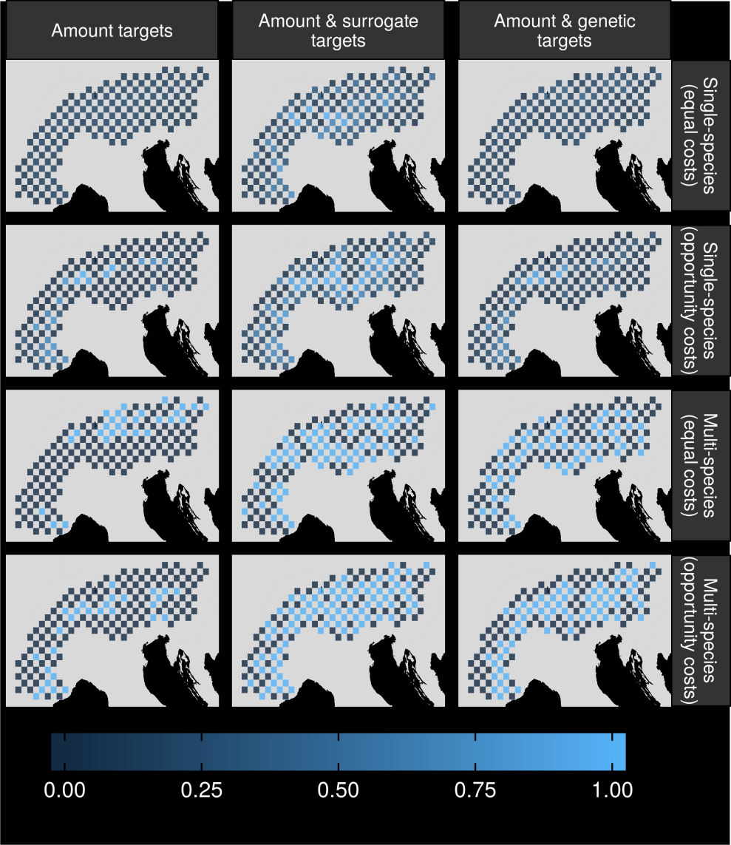
Can surrogates inform our decisions?
Hanson et al. 2017 PNAS

Slide 52
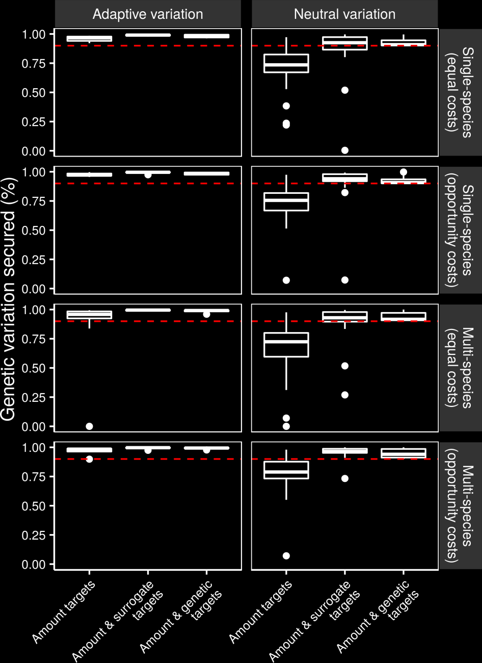
Can we make better decisions using surrogates?
Hanson et al. 2017 PNAS

Slide 53
Can we make better decisions using surrogates?
Hanson et al. 2017 PNAS

Slide 54
Many surrogates are often available,
how do our choices
affect the results?

Slide 55
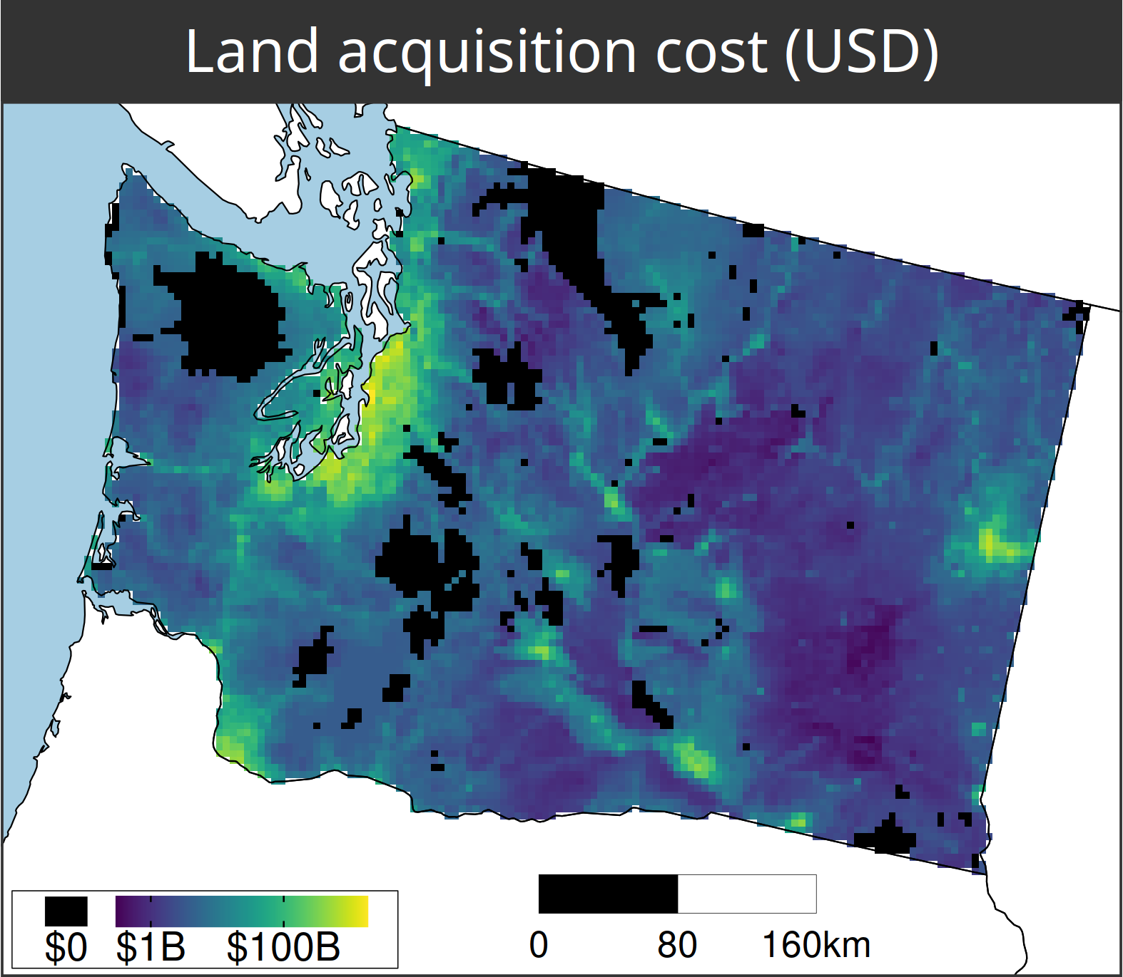
A comparison of approaches for including connectivity in systematic conservation planning
Washington State, USA
261 bird species
Land acquisition costs
Existing protected areas
Multiple land-uses
Multiple eco-systems
Hanson et al. 2022 J. Appl. Ecol.

Slide 56
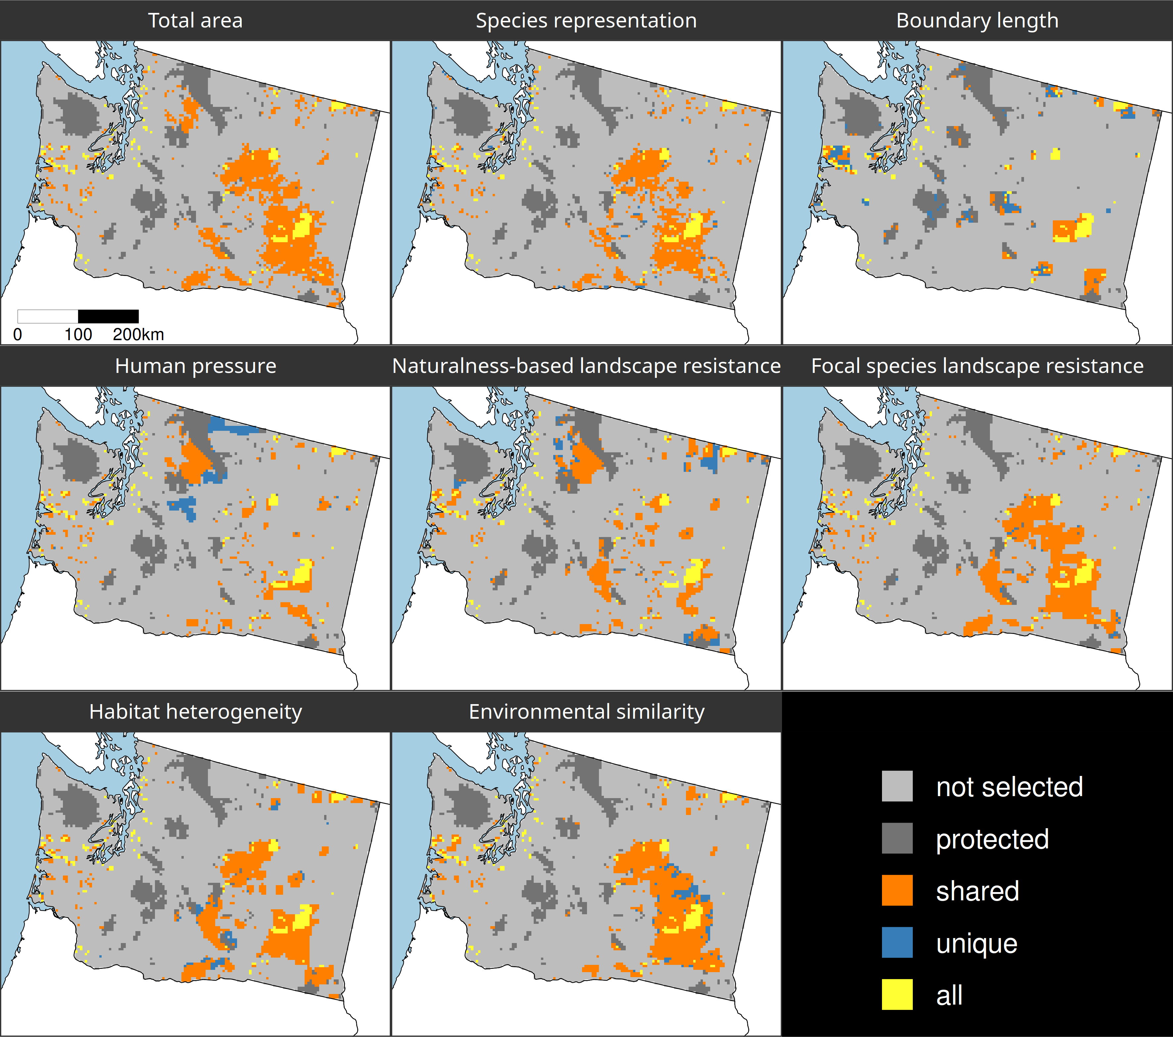
Different connectivity approaches produce different prioritizations
Different connectivity approaches can yield similar prioritizations

Slide 57
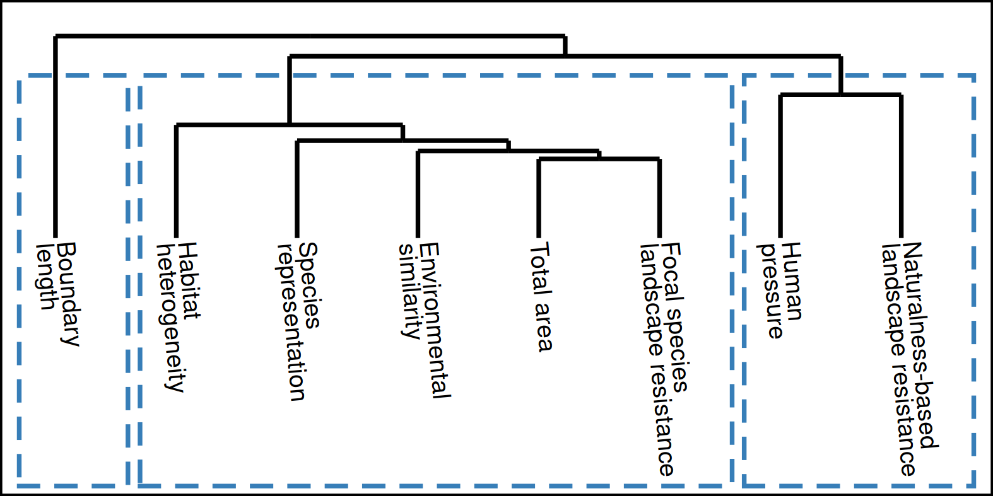
How do the prioritizations compare?
Approach
Habitat-based
Spatial
clustering
Resistance-based
Hanson et al. 2022 J. Appl. Ecol

Slide 58
Make better conservation decisions by using…
1. Better algorithms
2. Cost-effective data
3. Reliable surrogates

Slide 59




jeffrey.hanson@uqconnect.edu.au
github.com/jeffreyhanson
jeffrey-hanson.com

Slide 60
However, surrogates may not always work

Slide 61
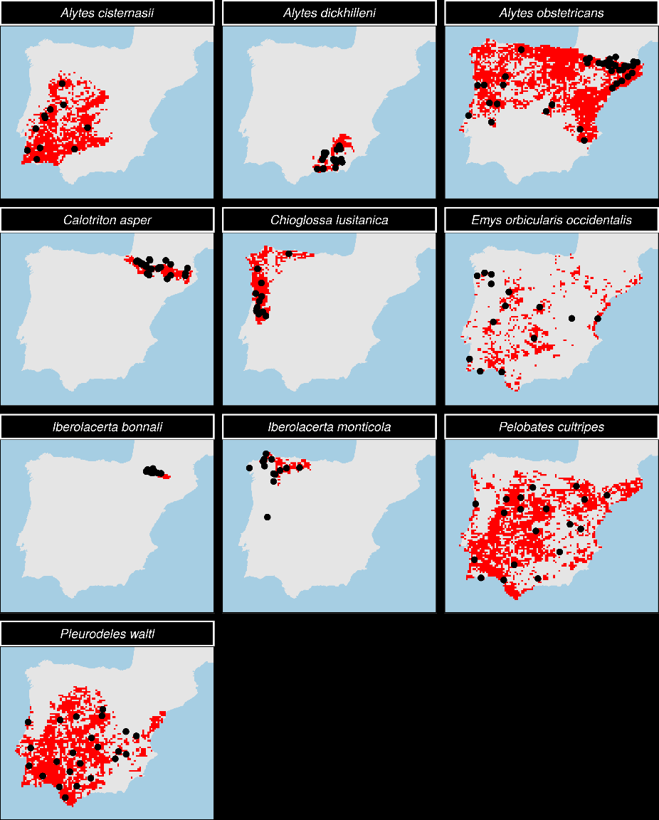
Evaluating surrogates of genetic diversity for conservation planning
7 amphibian species
3 reptile species
Iberian Peninsula =
HARD MODE
Microsatellite markers for neutral genetic variation
Hanson et al. 2021 Cons Biol

Slide 62
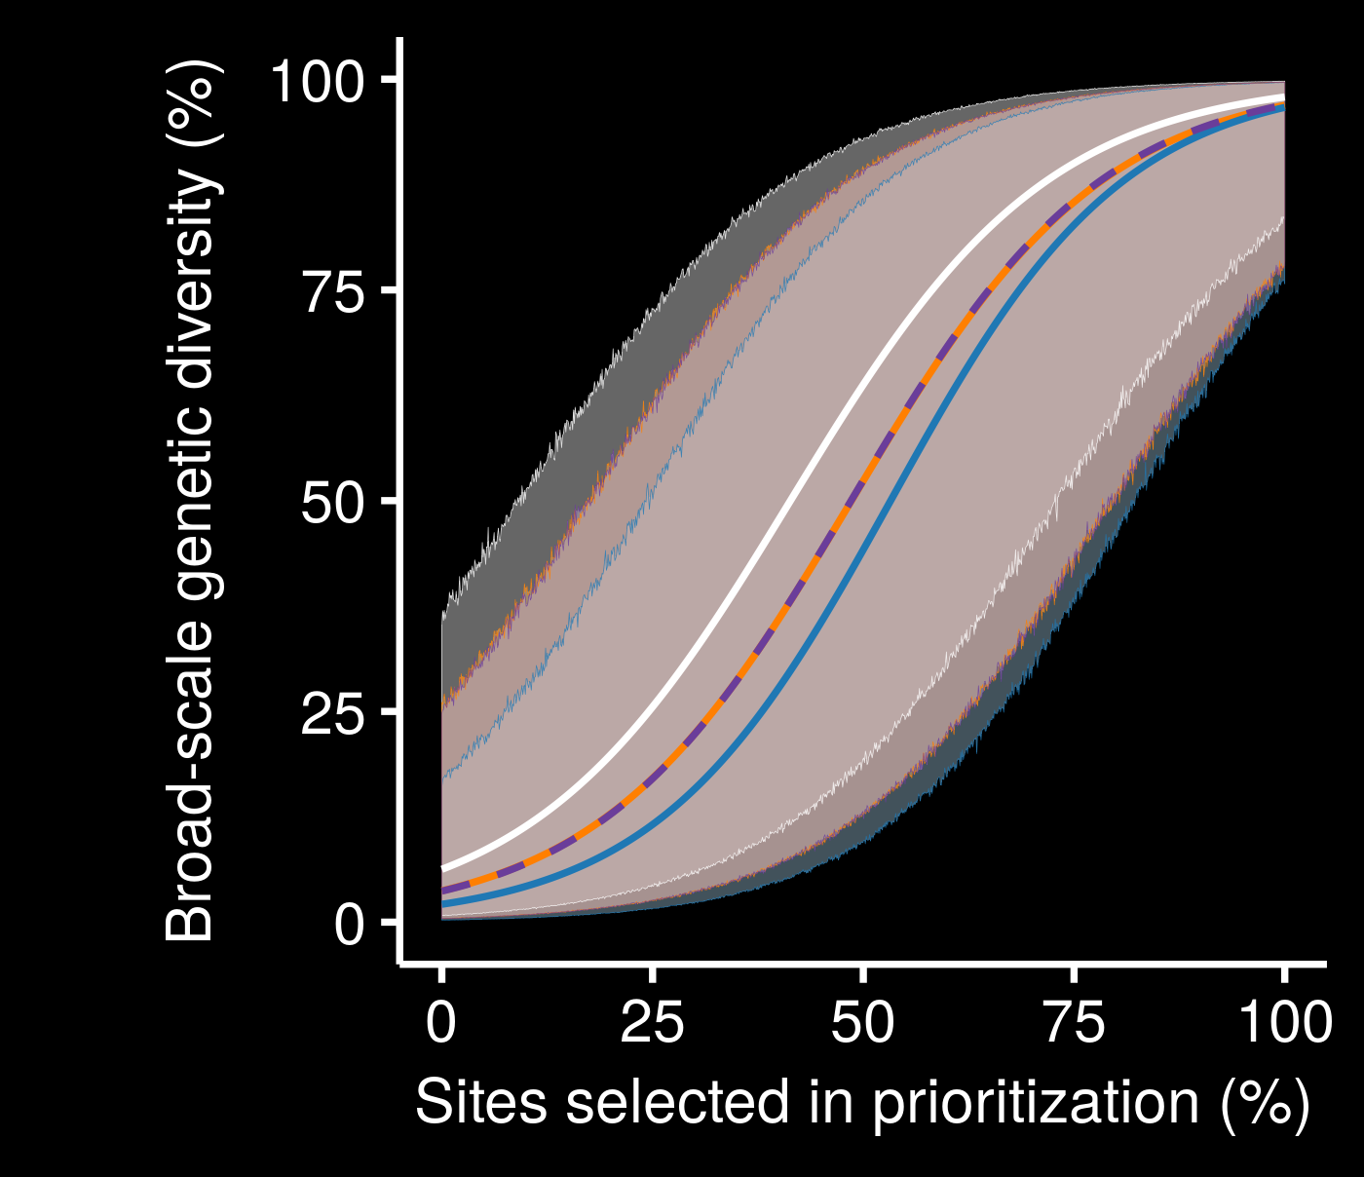
Surrogates for neutral genetic variation may not perform much better than random
Little performance improvement with low budget
genetic
geographic
random
resistance
Hanson et al. 2021 Cons Biol

